Slide 1
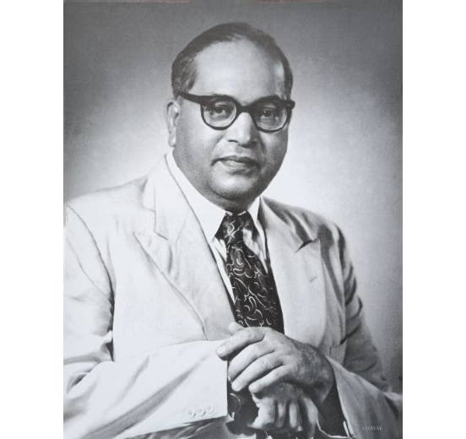
ARCHITECT OF SOCIAL JUSTICE
Dr. B. R. Ambedkar
Revolutionary Reformer, Economist, Jurist & Father of the Indian Constitution
1891 – 1956

Slide 2

FOUNDATIONAL BEGINNINGS
Biography & Scholarly Pursuit
Birth & Early Struggle
Born April 14, 1891, in Mhow. Faced severe untouchability and social isolation from childhood.
— Dr. B. R. Ambedkar
Unmatched Academic Mastery
Earned doctorates from Columbia University and the London School of Economics.
"Cultivation of mind should be the ultimate aim of human existence."
Legal & Intellectual Power
Called to the Bar at Gray's Inn, London, combining deep legal scholarship with social activism.

Slide 3



SOCIOLOGICAL ANALYSIS
The Theory of Graded Inequality
Ascending Reverence
Descending Contempt
Division of Laborers
Reverence increases with higher social status, reinforcing privilege.
Contempt increases downward, preventing unified solidarity among oppressed groups.
Caste is not merely division of labor, but an enforced division of laborers.

Slide 4
DIRECT SOCIAL MOBILIZATION
Revolution Against Caste
1924
1927
1930
1936
Bahishkrit Hitakarini Sabha
Mahad Satyagraha
Kalaram Temple Entry
Annihilation of Caste
Historic struggle asserting public water resource rights for untouchables.
Non-violent satyagraha demanding equal religious entry rights.
Seminal text demanding total dismantling of orthodox caste doctrine.
Institutional platform for socio-political awareness and educational welfare.

Slide 5
HUMAN RIGHTS CHAMPION
Leader of Depressed Classes & Social Justice
Political Empowerment
Secured electoral representation and statutory safeguards for depressed classes.
Article 17
Affirmative Action
Abolition of Untouchability
Pioneered reservation mechanisms in public employment and education.
Constitutional criminalization of untouchability and discrimination.
Gender Liberation
Championed the Hindu Code Bill granting women equal property and marital rights.

Slide 6


INTELLECTUAL WARFARE
Education & Journalism as Weapons
Journalistic Publications
The Revolutionary Mantra
Mooknayak (Leader of the Voiceless)
1920
"Educate. Agitate. Organize."
Bahishkrit Bharat (Excluded India)
1927
Education generates self-respect; agitation disrupts oppression; organization delivers lasting structural change.
Janata (The People)
1930
Prabuddha Bharat (Enlightened India)
1956

Slide 7



FINANCIAL FOUNDATIONS
Economist & Policy Architect
Reserve Bank of India
Public Finance Studies
Labor Rights Reforms
RBI operational guidelines were derived from Ambedkar's book The Problem of the Rupee.
Pioneered federal fiscal decentralization analysis in The Evolution of Provincial Finance.
Established 8-hour working days, maternity benefits, and technical training funds.

Slide 8
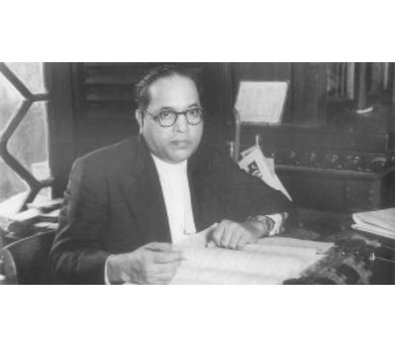
CONSTITUTIONAL FRAMEWORK
Father of the Indian Constitution
Drafting Committee Chairman
Spearheaded the formulation of the world's most detailed democratic constitution.
Trinity of Values
Enshrined Liberty, Equality, and Fraternity as indispensable life principles.
Constitutional Morality
Warned that democracy is a top-dressing on Indian soil requiring active cultivation.

Slide 9
PHILOSOPHICAL RENAISSANCE
Religion & Navayana Buddhism
Rejection of Dogma
Rejected orthodox social hierarchies that sanctified caste and human inequality.
"I like the religion that teaches liberty, equality, and fraternity."
Mass Conversion at Deekshabhoomi (1956)
Converted to Buddhism alongside 500,000 followers in Nagpur for spiritual emancipation.
— Dr. B. R. Ambedkar
Navayana (Neo-Buddhism)
Reinterpreted Buddhist philosophy through rationality, social justice, and morality.

Slide 10
NATIONAL IDENTITY & LEGACY
"Indians Firstly and Lastly"
"I do not want that our loyalty as Indians should be in the slightest way affected by any competitive loyalty, whether that loyalty arises out of our religion, out of our culture, or out of our language."
Bharat Ratna Awardee (1990) • Permanent Beacon of Equality & Human Rights
Jai Bhim • Thank You

Slide 11


Image Sources
http://tathagat.live/cdn/shop/products/IMG_20221031_162517.jpg?v=1729424465
Source: tathagat.live
https://clpr.org.in/wp-content/uploads/2020/11/Dr.-B.-R-Ambedkar-300x169.jpg
Source: clpr.org.in

