Slide 1

Gandhian Thought:
Swaraj & Satyagraha
An Analytical Exploration of Self-Rule and Non-Violent Resistance

Slide 2

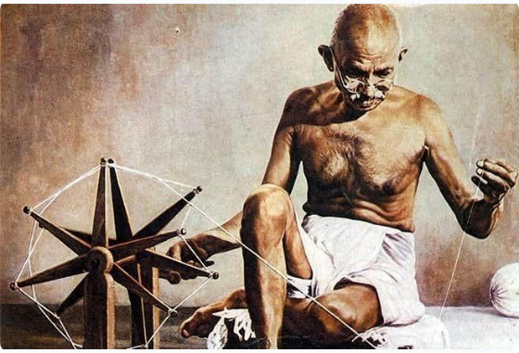
Context & Foundations
Twin Pillars of Gandhism
Mahatma Gandhi's political philosophy emerged from practical anti-racial struggles in South Africa and the national movement in India.
•
Satya (Truth): The ultimate reality and sovereign moral law governing existence.
•
Ahimsa (Non-Violence): The essential means to realise Truth in political and social life.
•
Dialectical Unity: Swaraj serves as the ultimate moral goal, while Satyagraha acts as the active technique.

Slide 3


Understanding Swaraj
Etymology & Philosophical Core
Critique in 'Hind Swaraj' (1909)
Derived from Sanskrit: Swa (Self) + Raj (Rule). It translates literally to "Self-Rule" or "Self-Governance".
In his seminal work Hind Swaraj, Gandhi argued that simply replacing British rulers with Indian elites without changing the system would be "English rule without the Englishman."
Gandhi expanded Swaraj beyond political independence from British colonial rule. True Swaraj demands mastery over one's mind, desires, and passions.
True freedom requires rejecting oppressive modern Western industrial civilization.

Slide 4





Four Dimensions of Swaraj
Moral & Spiritual
Political Governance
Economic Self-Reliance
Social Equality
Self-mastery, moral autonomy, and liberation from personal greed, anger, and material addictions.
Decentralization of power through Gram Swaraj (Village Republics) and participatory democracy.
Eradication of untouchability, promotion of communal harmony, and upliftment of all (Sarvodaya).
Swadeshi principles, promotion of cottage industries (Khadi), and local self-sufficiency.

Slide 5
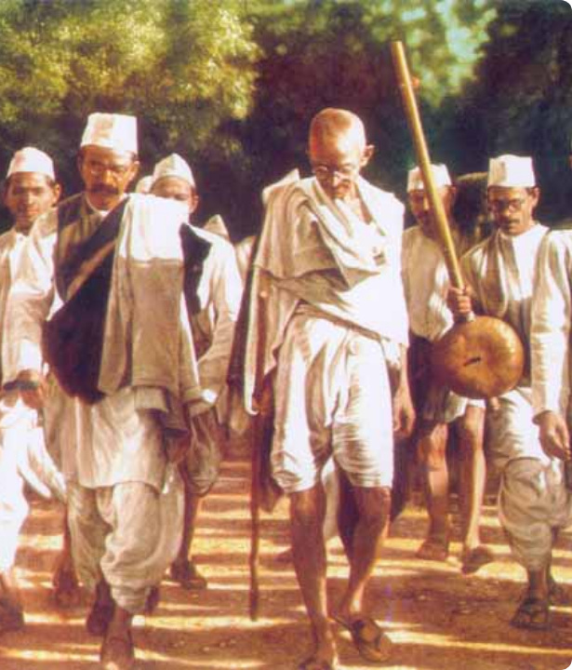
The Essence of Satyagraha
Truth-Force / Soul-Force
Satyagraha is composed of two words: Satya (Truth) and Agraha (Firmness or Insistence).
It represents non-violent resistance against oppression, seeking to convert the oppressor's heart through moral persuasion and voluntary endurance of suffering rather than coercion.

Slide 6

Satyagraha vs Passive Resistance
Feature | Passive Resistance | Satyagraha
Moral Foundation | Weapon of the weak; tactical choice | Weapon of the morally strong; spiritual imperative
Attitude to Adversary | Can harbor ill-will or hatred | Loves the opponent; opposes only the evil deed
Adherence to Ahimsa | Allows violence if political expediency demands | Strictly non-violent in thought, word, and deed
Ultimate Objective | Embarrass or defeat the adversary | Moral transformation and reconciliation

Slide 7
Techniques of Satyagraha
Non-Cooperation (Asahyog): Refusal to submit to unjust laws or collaborate with an oppressive administration.
Civil Disobedience (Savinay Avagya): Deliberate, open, and non-violent breaking of unconstitutional laws (e.g., Salt March 1930).
Fasting (Upvas): A tool of moral appeal and self-purification, reserved strictly as a last resort by trained Satyagrahis.
Hartal & Boycott: Voluntary suspension of business, work, and foreign goods to register principled public protest.

Slide 8
Qualities of a Satyagrahi
Personal Discipline & Vows
Purity of Means and Ends
A true Satyagrahi must practice absolute fearlessness (Abhaya), truthfulness, non-stealing, and non-possession (Aparigraha).
Gandhi insisted that means are as important as ends. Immoral methods can never yield morally sound political results.
A Satyagrahi accepts suffering upon themselves rather than inflicting pain upon the opponent.
Self-discipline is compulsory to withstand physical violence and imprisonment without retaliation.

Slide 9
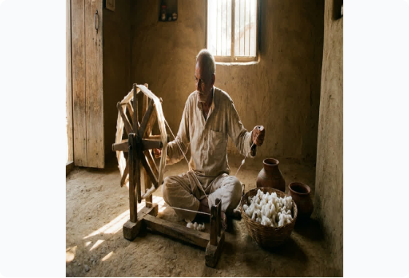
Economic Swaraj & Trusteeship
Village Economy & Trusteeship
Gandhi criticized centralizing industrial capitalism as inherently exploitative and violent.
•
Charkha (Spinning Wheel): Symbol of self-reliance, dignity of labor, and economic freedom.
•
Doctrine of Trusteeship: Wealthy individuals should act as trustees holding property for the welfare of society.

Slide 10

Political Decentralization
Gram Swaraj (Village Republics)
100%
Gandhi advocated for an "oceanic circle" model of power, where every village operates as an autonomous, self-sustaining democratic republic.
Grassroots Panchayati Raj
Rather than a pyramid structure where central authority rules downwards, power flows outwards from morally awake, active citizens.

Slide 11
Key Philosophical Axiom
“
Real Swaraj will come, not by the acquisition of authority by a few, but by the acquisition of the capacity by all to resist authority when it is abused.
— Mahatma Gandhi (Young India, 1925)

Slide 12
Questions & Discussion
Swaraj and Satyagraha in Contemporary Political Theory

Slide 13



Image Sources
https://irp.cdn-website.com/dced804e/dms3rep/multi/opt/celebrating-151-years-of-mahatma-gandhi-charkha-tales-1920w.jpg
Source: www.beekaylon.com
https://www.mkgandhi.org/images/gandhi21.jpg
Source: www.mkgandhi.org
https://anuprerna-bloomscorp.s3.ap-south-1.amazonaws.com/7O8Z8AAQJ0Y0IUMDW71PK2M6MA9305671.jpg
Source: anuprerna.com

