Slide 1
BA 5TH SEMESTER • INDIAN POLITICAL THOUGHT
Political Thought of Abul Fazl
Sovereignty, Divine Light, Social Contract, and Akbar's Secular Governance
MUGHAL STATECRAFT & IDEOLOGY

Slide 2



ACADEMIC OVERVIEW
Context & Major Texts
Grand Vizier & Intellectual
Court historian and chief advisor to Emperor Akbar (1551–1602).
Akbarnama
Official chronicle documenting political history and military expansion.
Ain-i-Akbari
Third volume detailing administrative institutions and state philosophy.

Slide 3



THEORY OF KINGSHIP
Divine Light (Farr-i-Izadi)
Rejection of Zill-i-Ilahi
Rejects "Shadow of God" concept; king receives active divine radiance.
Suhrawardi Illuminationism
Monarchy is a ray of divine light emanating directly from God, elevating sovereign authority above clerical dictates.
Moral Obligation
Divine favor requires ruler to possess paternal affection for subjects.

Slide 4


BASIS OF AUTHORITY
Sovereignty as Social Contract
Subjects grant obedience and taxes; sovereign guarantees protection of four essential assets.
Jaan
Maal
Namus
Din
Protection of Life
Protection of Property
Protection of Honor
Freedom of Religion

Slide 5


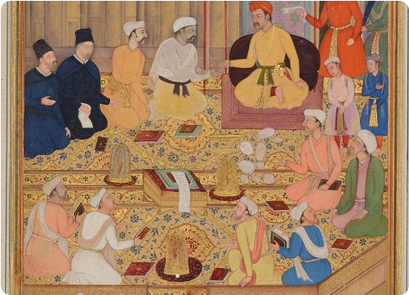
CORE DOCTRINE
Sulh-i-Kul (Universal Peace)
State Neutrality
Sovereign stands above all religious sects and treats subjects equally.
Abolition of Discriminatory Taxes
Repealed Jizya tax (1564) and pilgrimage taxes across the empire.
Harmony in Diversity
Social stability maintained through mutual tolerance and state arbitration.

Slide 6


SECULAR STATECRAFT
Separation of Religion and Politics
Traditional Orthodoxy
Abul Fazl's Model
Clerical Supremacy: Ulema dictated state policy and judicial interpretations.
Mahzar (1579): Emperor as final arbiter over religious disputes.
Religious Exclusion: Non-Muslims subjected to discriminatory legal codes.
Rational Governance: Public interest and reason supersede dogma.

Slide 7
PART II • SOCIAL ORDER & ADMINISTRATION
The Ideal Monarch & Social Structure

Slide 8




ROYAL IDEAL
Virtues of the Just Ruler (Insan-i-Kamil)
Commitment to Reason
Paternal Care
Impartial Justice
Decision-making guided by intellect, science, and empirical inquiry.
Treating all subjects like children regardless of creed or ethnicity.
Enforcing equity and punishing tyranny to maintain public trust.

Slide 9




SOCIAL ARCHITECTURE
Four-Fold Division of Society
CLASS I
CLASS II
CLASS III
CLASS IV
Warriors
Merchants
Learned
Laborers
Equivalent to Fire; protect state security.
Equivalent to Air; drive commerce & trade.
Equivalent to Water; scholars & judges.
Equivalent to Earth; farmers & artisans.

Slide 11


EXAM PREPARATION
Critical Evaluation & Exam Takeaways
Academic Criticism
Key Syllabus Points
Royal Apologist: Justified all autocratic decisions of Emperor Akbar.
Farr-i-Izadi & Sulh-i-Kul: Core theoretical pillars of Mughal statecraft.
Utopian Vision: High ideals of Insan-i-Kamil rarely fully operational.
Social Contract: Protection of Jaan, Maal, Namus, Din.

Slide 12
BA 5TH SEMESTER • SUMMARY COMPLETE
Questions & Discussion
Abul Fazl's contribution marks the transition of medieval Indian statecraft toward secular tolerance and composite culture.

Slide 13


Image Sources
https://upload.wikimedia.org/wikipedia/commons/d/d0/Shamsa_artwork%2C_from_an_illustrated_%27Ain-i-Akbari%27_manuscript_commissioned_by_the_Sikh_Empire_%281%29.jpg?utm_source=commons.wikimedia.org&utm_campaign=index&utm_content=original
Source: commons.wikimedia.org
https://www.worldhistory.org/img/r/p/1500x1500/12135.jpg
Source: www.worldhistory.org

