Slide 1
POLITICAL THEORY
Journey of
the State
KINSHIP
CITY
EMPIRE
From stateless societies to the modern nation-state
FEUDAL
A chronological, comparative classroom presentation
NATION
01
Notes:
Begin with a question: “Was the State always present wherever human beings lived?” Allow two or three answers. Then say: “Today we will see that the State is not timeless. It is a historical institution. Its form changed as society, economy, religion, warfare and ideas changed.” Point to the vertical journey on the right and tell students that each stage solves some problems but creates new ones.
Interaction: Ask students to predict which stage first created the idea of citizenship based on law.
[Sources]
- User-provided text: “Journey of the State,” pp. 43–45.

Slide 2
JOURNEY OF THE STATE
The State is historical—not a timeless human arrangement
Central idea
Political organization changed when society changed.
Think of the State as a
changing answer to one question:
Who has the authority
to make and enforce
collective decisions?
•
Economy: hunting → agriculture → trade → industry
•
Authority: kinship → rulers → layered lords → sovereign government
•
Identity: clan or locality → citizenship → territorial nation
02
Notes:
Say: “When we call the State a historical phenomenon, we mean it emerged at a particular stage and later changed form. Human society came first; the modern nation-state came much later.” Use a familiar analogy: a university existed before its present departments, regulations and digital systems. The institution developed as needs and conditions changed. In the same way, political authority changed form.
Ask: “If a village settles disputes through elders but has no fixed territory, bureaucracy or central ruler, should we immediately call it a State?” Use their answers to lead into stateless societies.
[Sources]
- User-provided text: “Journey of the State,” pp. 43–45.

Slide 3
JOURNEY OF THE STATE
Six stages reveal a gradual concentration—and later limitation—of power
1
2
3
4
5
6
Stateless
societies
City-
states
Roman
Empire
Feudal
order
Absolutist
State
Constitutional
nation-state
No fixed centre
Power disperses
Power is limited by law
03
Notes:
Walk slowly across the timeline. Say: “This is not a perfectly straight or universal path. Different regions followed different trajectories, and forms overlapped. The timeline is a learning device.” Stress the larger movement: authority became more organized, then centralized, and later constitutionally limited.
Quick check: Ask one student to identify the stage with the weakest central authority. Ask another to identify the stage where authority becomes strongly centralized.
[Sources]
- User-provided text: “Journey of the State,” pp. 43–45.

Slide 4
JOURNEY OF THE STATE
Before the State, authority rested in kinship, custom and community
Important distinction
Stateless society
No State ≠ no order
•
No centralized political authority
A community may have elders, councils, rituals and sanctions. What it lacks is a centralized authority claiming rule over a definite territory.
•
No fixed territorial allegiance
•
Rules arise from custom and kinship
•
Leadership may exist without statehood
Example: clan elders settle a dispute through custom—not through a territorial court system.
04
Notes:
Start with the phrase on the right: “No State does not mean no order.” Students often confuse the absence of a modern government with chaos. Explain that customary rules can be strong even without a central authority.
Simple example: Two families in a clan disagree about land use. Elders hear both sides and invoke inherited custom. This is authority, but it may not yet be a State because there is no specialized government ruling a definite territory.
Interactive question: “What extra features would transform this arrangement into something closer to a State?” Look for territory, central institutions, taxation, law and enforcement.
Mention Engels carefully: in the Marxian reading used in the source, the State emerges alongside class divisions, so calling every tribal organization a ‘tribal state’ may be misleading.
[Sources]
- User-provided text: “Journey of the State,” pp. 43–45.

Slide 5
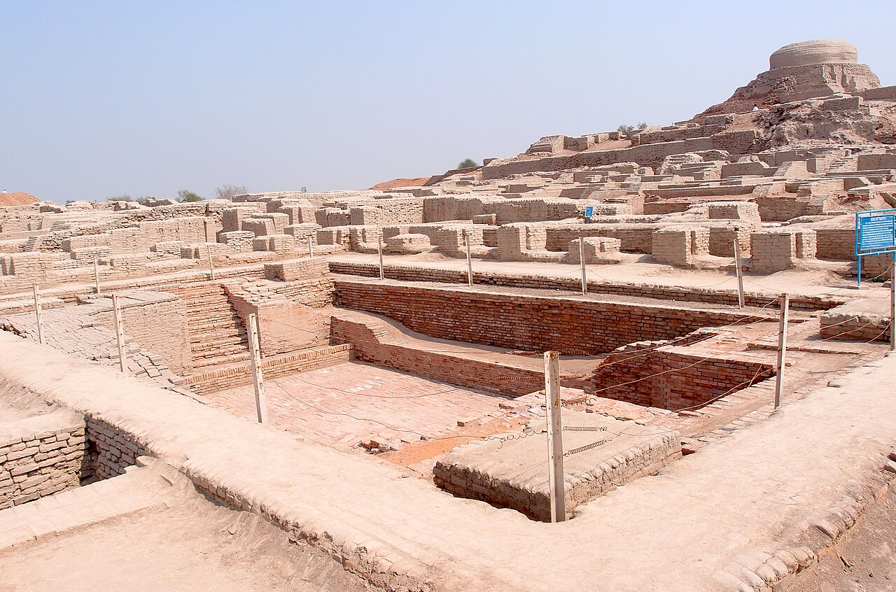
JOURNEY OF THE STATE
Agriculture and river civilizations created new administrative demands
Why rivers mattered
•
Surplus food supported towns and rulers
•
Irrigation required coordination
•
Land and harvests could be taxed
•
Armies and officials protected rule
Ganges • Nile • Euphrates • Yangtze / Yellow River
Mohenjo-daro: an urban civilization of the Indus region
05
Notes:
Use the photograph to move away from a purely European story. Say: “Large agrarian settlements required coordination: water management, storage, labour, defence and dispute settlement.” This does not mean every river civilization had the same political system. It means settled agriculture made more complex administration possible.
Ask students to imagine one practical problem: “If five villages depend on the same canal, who decides when each village receives water?” Their answer shows why coordination and authority grow.
The source mentions civilizations along the Ganges, Nile, Euphrates and Yangtze or Yellow River. Add that Mohenjo-daro reminds us that the Indian subcontinent had complex urban life long before the European nation-state.
[Sources]
- User-provided text: “Journey of the State,” pp. 43–45.
- Image: Saqib Qayyum, “Mohenjo-daro.jpg,” Wikimedia Commons, CC BY-SA 3.0, https://commons.wikimedia.org/wiki/File:Mohenjo-daro.jpg
[Sources]
- User-provided text: “Journey of the State,” pp. 43–45.

Slide 6
JOURNEY OF THE STATE
Early agrarian empires joined economic control with monarchical power
ECONOMY
AUTHORITY
SUBJECTS
Agriculture produced surplus; land and harvest became the fiscal base.
A monarch and officials organized taxation, labour and coercion.
People were governed primarily as subjects—not equal citizens.
Gettell’s harsh image: the ruler appeared chiefly as “slave driver and tax collector.”
06
Notes:
Explain the expression on the bottom as a critical description, not as a claim that every ruler behaved identically. The point is that many early agrarian monarchies were organized around extracting labour and revenue and maintaining obedience.
Use a concrete example: A ruler orders a canal to be built. The canal benefits agriculture, but the same authority can demand forced labour and collect taxes. Political power therefore has both coordinating and coercive sides.
Ask: “At this stage, is a person mainly a citizen with rights or a subject under a ruler?” Let students justify their choice.
[Sources]
- User-provided text: “Journey of the State,” pp. 43–45.

Slide 7
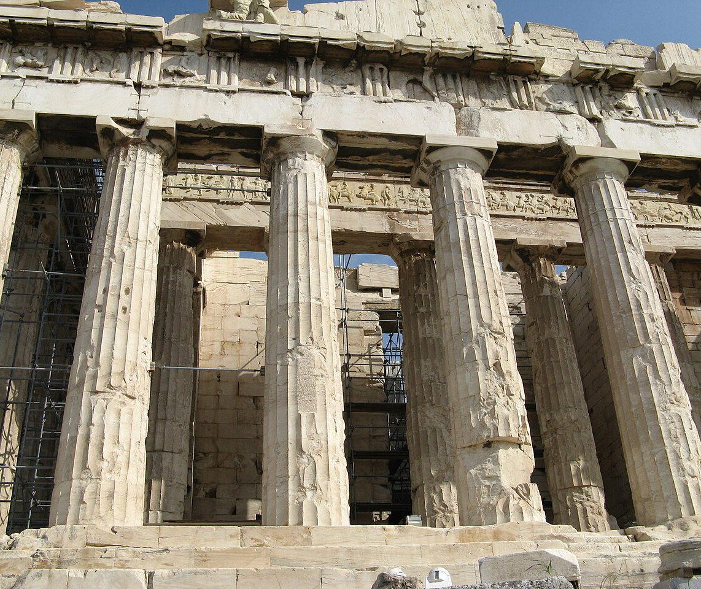
JOURNEY OF THE STATE
The city-state made political participation visible within a small territory
Greek polis
•
A city and its surrounding territory formed one political unit
•
Citizens could participate directly in public decisions
•
Athens and Sparta later absorbed smaller city-states
Eastern comparison: Indian Janapadas show that localized political communities were not uniquely Greek.
07
Notes:
Say: “A city-state is not merely a city. It is a small sovereign political community consisting of the city and its surrounding territory.” Explain direct democracy with a simple classroom comparison: instead of electing a class representative to decide, all eligible members assemble and vote directly.
Do not romanticize the model as universal equality. Keep the core point: participation was more direct because the political community was small.
Then ask: “Why would direct participation become harder when territory and population expand?” Their answers prepare the transition to empire.
[Sources]
- User-provided text: “Journey of the State,” p. 43.
- Image: Yair Haklai, “Parthenon-Acropolis of Athens-2.jpg,” Wikimedia Commons, CC BY 3.0, https://commons.wikimedia.org/wiki/File:Parthenon-Acropolis_of_Athens-2.jpg
[Sources]
- User-provided text: “Journey of the State,” pp. 43–45.

Slide 8
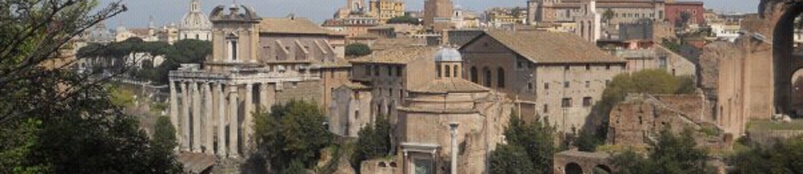
JOURNEY OF THE STATE
Rome transformed a city-state into a law-governed imperial order
ROMAN LAW
CITIZENSHIP
RULE OF LAW
A systematized legal code distinguished public authority from society.
Legal status mattered; citizenship was not defined only by residence.
The idea grew that state power itself should have a legal foundation.
08
Notes:
Begin: “Rome’s contribution was not only military expansion. Its most enduring political contribution was legal organization.” Explain dominium simply as the emperor’s claim of ownership and control over land and the people connected with it. Then distinguish res publica—the public realm—from purely private life.
Use an everyday illustration: If a teacher punishes a student merely because she is powerful, that is personal rule. If authority must follow an established rule applicable to cases, power begins to be legally structured. Rome did not create modern constitutional democracy, but Roman law helped later thinking about public power and citizenship.
Ask: “Which Roman contribution still appears in modern constitutions—law, citizenship, or rule of law?” Answer: all three, though in transformed forms.
[Sources]
- User-provided text: “Journey of the State,” pp. 43–44.
- Image: Erik Drost, “Ancient Roman Forum Panorama,” Wikimedia Commons, CC BY 2.0, https://commons.wikimedia.org/wiki/File:Ancient_Roman_Forum_Panorama_(5987190934).jpg
[Sources]
- User-provided text: “Journey of the State,” pp. 43–45.

Slide 9
JOURNEY OF THE STATE
Expansion strengthened Rome—then made imperial control harder to sustain
Imperial growth
Internal strain
External pressure
Larger territory
More borders
More administration
Rural unrest
Slave rebellions
Class tensions
Germanic invasions
from the north
→
+
Result: centralized imperial authority eroded
09
Notes:
Explain cause and effect rather than memorizing a list. Expansion brought resources and prestige, but it also increased the cost of defence and administration. Internal unrest weakened cohesion, while invasions added external pressure.
Use a simple analogy: A college with one building may be managed informally. If it suddenly expands across ten distant campuses without increasing coordination, control becomes difficult. The analogy is imperfect, but it shows the administrative burden of scale.
Transition: “When Roman central authority weakened, power did not disappear. It broke into many overlapping local centres. That is the setting of feudalism.”
[Sources]
- User-provided text: “Journey of the State,” pp. 43–45.

Slide 10
JOURNEY OF THE STATE
Feudalism exchanged land and protection for loyalty and service
LORD
VASSAL
FIEF
grants land + protection
gives loyalty + military service
land held on tenure
Political bond: lord ↔ vassal
Economic bond: lord ↔ serf
DEPENDENT PEASANTRY
labour and dues sustain the order
10
Notes:
Teach the vocabulary as relationships, not isolated definitions. A benefice or fief is a grant of land or rights. The vassal receives protection and occupation of land; in return, the vassal owes loyalty, homage and often military service. The vassal may then create dependants below him.
Distinguish two relationships. Lord–vassal is principally political: loyalty and service. Lord–serf is principally economic: labour, dues and dependence.
Interactive example: “Suppose a king grants a local noble control over land because the noble promises soldiers. Who actually cultivates the land?” The answer—peasants or serfs—reveals why the system is both political and economic.
[Sources]
- User-provided text: “Journey of the State,” pp. 43–45.

Slide 11
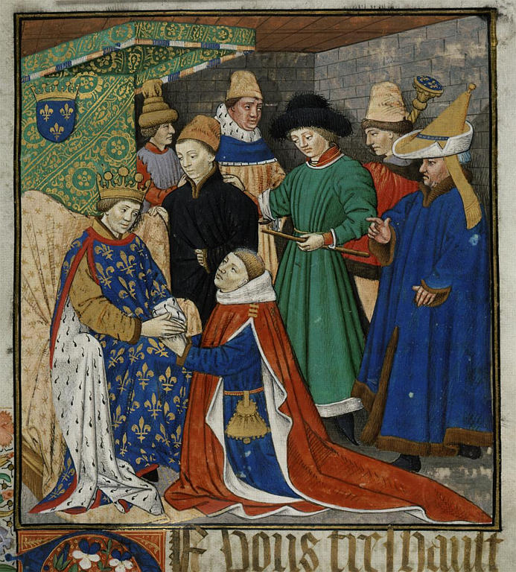
JOURNEY OF THE STATE
Feudal power formed a pyramid—but authority was dispersed
MONARCH / SUZERAIN
GREATER LORDS
VASSALS / KNIGHTS
SERFS / PEASANTS
Land, protection ↓
↑ Labour, dues, service
11
Notes:
Point to the manuscript image: it depicts homage—a vassal formally acknowledging a superior lord. Then point to the pyramid. The pyramid looks centralized, but explain the paradox: each level held real local power. The monarch was often only the highest lord, not an absolute sovereign.
Use Stuart Hall’s distinction in simple language: the feudal monarch was a suzerain—supreme within a chain of personal loyalties—but not fully sovereign in the modern sense. Different authorities could overlap, and a person might owe obligations to more than one power centre.
Ask: “Why can a pyramid still produce weak central authority?” Expected answer: because power is delegated and tied to personal land-based relations.
[Sources]
- User-provided text: “Journey of the State,” p. 44.
- Image: Maître de Jeanne de Laval, “Aveu René 2.jpg,” c. 1469, Archives nationales/Wikimedia Commons, public domain, https://commons.wikimedia.org/wiki/File:Aveu_Ren%C3%A9_2.jpg
[Sources]
- User-provided text: “Journey of the State,” pp. 43–45.

Slide 12
JOURNEY OF THE STATE
Medieval authority overlapped: lord, monarch and Church all claimed obedience
SECULAR POWER
SPIRITUAL POWER
monarchs • lords
land • military service
OVERLAPPING
CLAIMS
Church • papacy
religious authority
Central problem: Who possesses the final, supreme authority?
12
Notes:
Describe a simple conflict. A monarch appoints an official or taxes Church land; the Church objects and claims higher spiritual authority. Who has the final word? Medieval Europe often lacked a single accepted answer.
This conflict matters because it helped generate the later idea of sovereignty. Papal claims to supreme spiritual power provoked monarchs to assert a supreme, independent secular authority. Machiavelli later gave forceful expression to autonomous political rule.
Ask the class: “Can two institutions both be supreme in the same field?” Let the tension sit for a moment. Then say that modern sovereignty develops partly as an attempt to end this ambiguity.
[Sources]
- User-provided text: “Journey of the State,” pp. 43–45.

Slide 13
JOURNEY OF THE STATE
Feudalism weakened when knowledge, production and exchange changed
01
02
03
04
RENAISSANCE
SCIENCE
COMMERCE
PRODUCTION
Human-centred inquiry challenged inherited authority.
New modes of enquiry weakened unquestioned religious claims.
Trade-based relations expanded beyond local feudal bonds.
Agrarian obligations gave way to new economic relations.
Outcome: personal, local rule gives way to territorially organized monarchy
13
Notes:
Treat these as connected processes. Renaissance and scientific inquiry questioned established intellectual authority. Commercial relations connected people beyond local estates. Changes in production weakened the economic foundations of serfdom. Stronger territorial monarchies then absorbed smaller centres of power.
Simple example: A merchant trading across several regions needs predictable roads, currency, contracts and security. Fragmented local rules become an obstacle. A centralized authority can promise uniformity.
Ask: “Which change is economic, which is intellectual, and which is political?” Then emphasize that historical transformations rarely have only one cause.
[Sources]
- User-provided text: “Journey of the State,” pp. 43–45.

Slide 14
JOURNEY OF THE STATE
Absolutism concentrated territory, taxation and armed force under one sovereign
ONE SOVEREIGN HEAD
ABSOLUTIST
MONARCH
TERRITORY
LAW & ORDER
TAXATION
STANDING ARMY
smaller units absorbed
more uniform rule
central revenue system
paid by public revenue
Theory of divine right: royal authority was defended as deriving directly from God.
14
Notes:
Define absolutism carefully: not simply a cruel king, but a system in which political power is gathered under a single sovereign head. The key institutional developments are unified territory, more regular law and security, central taxation, and a standing army.
Contrast the army with feudal service. Under feudalism, nobles owe soldiers through personal obligations. Under absolutism, a standing national army is maintained continuously through state revenue. Machiavelli criticized unreliable mercenaries and favoured national forces.
Ask: “Why does taxation matter for sovereignty?” Because a government that reliably raises revenue can maintain officials, courts and armed forces without depending entirely on feudal lords.
[Sources]
- User-provided text: “Journey of the State,” pp. 43–45.

Slide 15
JOURNEY OF THE STATE
Three revolutions changed the source—and limits—of political authority
1688
Glorious Revolution
Constitutional limits on monarchy
1776
American Revolution
Popular sovereignty and representative government
1789
French Revolution
Liberty, equality and rights of citizens
Together they helped recast subjects as rights-bearing citizens.
15
Notes:
Avoid presenting the revolutions as identical. Say: “Each arose in a different context, but together they changed the vocabulary of legitimate rule.” The central shift is from authority justified mainly by monarchy and divine right toward authority justified through constitutionalism, popular sovereignty and rights.
Everyday example: A hostel warden may have authority, but students ask two questions: Who gave this authority? What rules limit it? Modern constitutional politics asks the same questions of the State.
Quick interaction: Assign one principle to each row—limits, consent, rights—and ask students to explain the connection in one sentence.
[Sources]
- User-provided text: “Journey of the State,” pp. 43–45.

Slide 16
JOURNEY OF THE STATE
Constitutionalism organizes power by dividing it, limiting it and making it answerable
1
DIVIDE
2
LIMIT
3
ANSWER
Separation of powers
Charter of rights
Responsible government
Authority is distributed among institutions so no single organ controls everything.
Government cannot legitimately cross protected boundaries.
Rulers must justify decisions and remain accountable to democratic institutions.
Constitutionalism is more than having a written constitution—it requires effective restraints on power.
16
Notes:
Teach the three verbs: divide, limit, answer. First, power is divided through separation of powers. Second, rights limit what government may do. Third, responsible government makes office-holders answerable.
Use a college example: The principal, governing body and university each have different powers; written rules protect students; and decisions may require explanation or review. The analogy shows institutional restraint, though a State is much more complex.
Clarify the bottom sentence: A constitution can exist on paper while power remains arbitrary. Constitutionalism means the rules actually structure and restrain public authority.
Ask students to give one Indian example for each verb: divide, limit and answer.
[Sources]
- User-provided text: “Journey of the State,” pp. 43–45.

Slide 17
JOURNEY OF THE STATE
The global journey was unequal because colonialism imposed the State from outside
EUROPE & NORTH AMERICA
AFRICA, ASIA & LATIN AMERICA
Nation-state institutions developed through internal conflicts over monarchy, rights, territory and representation.
Many societies encountered the modern State through conquest, imposed borders, extraction and colonial administration.
Therefore, the European sequence is influential—but not a universal template.
17
Notes:
This is the critical correction to the timeline. Say: “The nation-state emerged through particular European histories, but colonial powers exported administrative structures to societies with different political traditions.” Colonized populations did not experience the State first as equal sovereignty; they often experienced it as rule by an external imperial power.
Explain the source’s master–slave analogy as a critique of colonial hierarchy: colonies served imperial interests rather than exercising equal sovereignty.
Ask: “What problems arise if we treat European history as the natural history of every society?” Expected answers: it erases indigenous institutions, ignores conquest and assumes one path of development.
[Sources]
- User-provided text: “Journey of the State,” pp. 43–45.

Slide 18
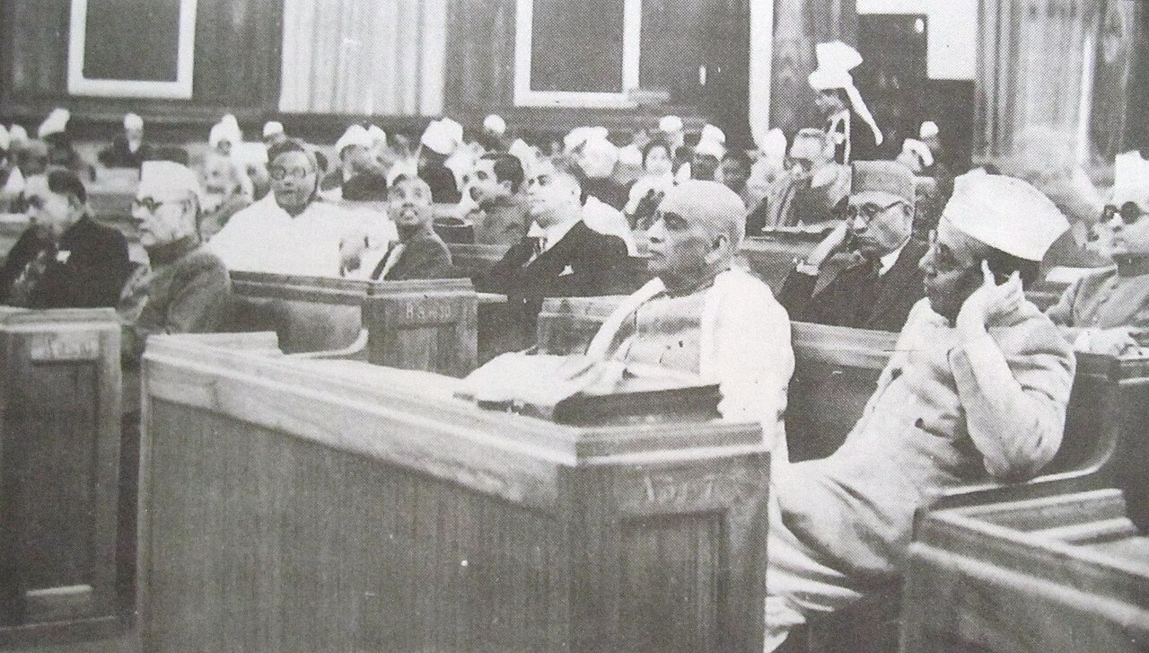
JOURNEY OF THE STATE
Independent India transformed colonial administration through popular constitution-making
A decisive transformation
•
From imperial rule to popular sovereignty
•
From colonial subjects to citizens
•
From administrative command to constitutional government
•
From imposed authority to a republic claiming democratic legitimacy
The Constituent Assembly, 1946
18
Notes:
Use this image as the bridge between the global history and India. Say: “Independence did not erase every colonial institution overnight. But constitution-making changed the claimed source and purpose of authority.” Authority was now to be derived from the people, exercised through constitutional institutions and limited by rights.
Simple contrast: Under colonial rule, Indians were governed without equal control over sovereign power. Under the Constitution, people are citizens and the opening claim is ‘We, the People of India.’
Ask: “Which earlier historical contributions are visible here?” Students may identify Roman law, sovereignty, territorial government, rights, constitutionalism and representative institutions.
[Sources]
- User-provided text: “Journey of the State,” p. 45.
- Image: “Indian Constituent Assembly.JPG,” 11 December 1946, Wikimedia Commons, public domain in India, https://commons.wikimedia.org/wiki/File:Indian_Constituent_Assembly.JPG
[Sources]
- User-provided text: “Journey of the State,” pp. 43–45.

Slide 19
JOURNEY OF THE STATE
Each stage reorganized territory, authority and the status of the governed
Stage
Territory
Authority
People
Core legacy
Stateless
Fluid
Kinship/custom
Members
Community order
City-state
Small/local
Citizen assembly
Citizens
Participation
Roman Empire
Expansive
Emperor + law
Legal statuses
Law/citizenship
Feudal
Fragmented
Overlapping lords
Dependants
Layered authority
Absolutist
Unified
Sovereign monarch
Subjects
Central state
Constitutional
National
Limited government
Citizens
Rights/accountability
19
Notes:
Use this as a revision slide. Read by columns rather than rows. First compare territory: fluid, small, expansive, fragmented, unified, national. Then compare authority. Finally compare how people are understood—as members, citizens, legal statuses, dependants, subjects and citizens again in a fuller constitutional sense.
Interactive activity: Cover the final column mentally and ask students to supply one legacy of each stage. Or choose any two rows and ask: “What changed, and why did it matter?”
Emphasize continuity: later stages do not completely erase earlier ones. Modern States still use law inherited from Rome, territorial sovereignty strengthened by absolutism, and rights developed through constitutional revolutions.
[Sources]
- User-provided text: “Journey of the State,” pp. 43–45.

Slide 20
JOURNEY OF THE STATE
The modern State is a layered historical achievement—and an unfinished project
LAW
SOVEREIGNTY
RIGHTS
ACCOUNTABILITY
Final classroom challenge
Choose one present-day State. Which historical layer is strongest—and which remains incomplete?
Who rules?
By what law?
Within which territory?
With whose consent?
Under what limits?
20
Notes:
Close by returning to the opening question. Say: “The State is not one invention made at one moment. It carries several historical layers: Roman law, the sovereignty strengthened by territorial monarchy, constitutional rights, and democratic accountability.”
Run the final challenge as a two-minute think–pair–share. Students select any present-day State and use the five questions at the bottom. They should identify one strength and one unfinished problem.
Possible example: In a constitutional democracy, territory and legal institutions may be stable, but equality, rights protection or accountability may remain incomplete. This shows why the journey of the State is not simply finished.
Exit question: “In one sentence, explain why the modern nation-state cannot be understood only by studying present institutions.” Expected idea: because those institutions are products of long social, economic, political and intellectual transformations.
[Sources]
- User-provided text: “Journey of the State,” pp. 43–45.

