Slide 1
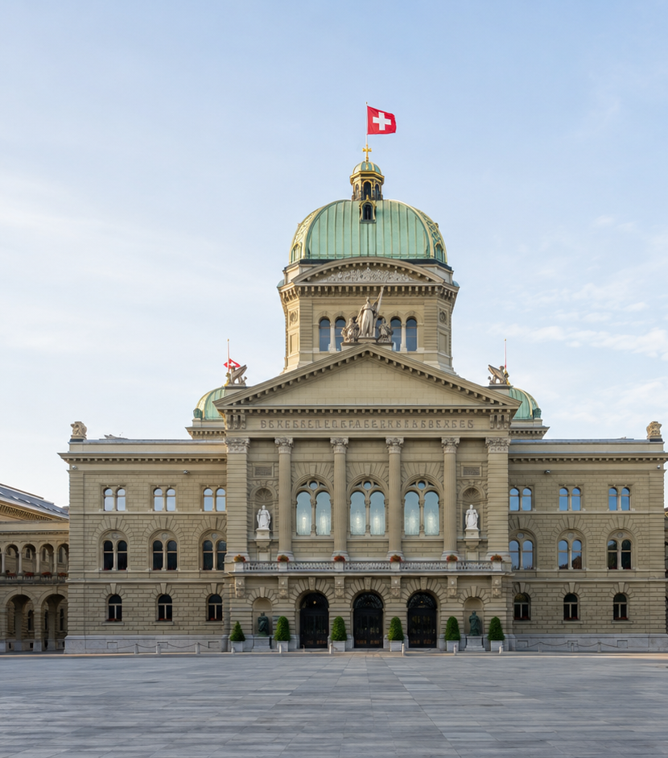
UNIT IV
The Federal Parliament
of Switzerland
Introduction & The National Council
Subject: Political Science | Semester: 5th Semester
Course: POL050304: Comparative Government and Politics
Created by Dr. Parismita Bhagawati
Updated with official Swiss facts • August 2026
Notes:
Welcome students. In this class we will understand the Federal Assembly of Switzerland and then focus on the National Council. Keep one idea in mind from the beginning: Swiss Parliament is constitutionally powerful, but direct democracy means the people can still have the final word on many important questions.

Slide 2
Learning roadmap
What should you be able to explain in an examination?
1
Define the Federal Assembly
structure + constitutional status
2
Explain bicameralism
National Council + Council of States
3
Understand the National Council
composition, election, tenure, sessions
4
Explain Swiss distinctiveness
direct democracy, no official opposition
5
Use scholars in answers
Codding, Rappard and Bryce
Notes:
Today we are not simply memorising facts. We will build the answer step by step. First: what is the Federal Assembly? Second: why are there two chambers? Third: what exactly is the National Council and how is it elected? Finally, we will connect the textbook scholars to the modern constitutional position.

Slide 3
Exam-ready definition: Federal Assembly
A definition you can directly use in a 2-mark or introductory paragraph
EXAM DEFINITION
“The Federal Assembly is the bicameral federal legislature of Switzerland. It consists of the National Council (200 members), representing the people, and the Council of States (46 members), representing the cantons. Under Article 148 of the Federal Constitution, it is the supreme authority of the Confederation, subject to the rights of the People and the Cantons; the two chambers are of equal standing.”
246
200
46
2
total members
National Council
Council of States
equal chambers
Sources: Federal Constitution, Arts. 148–150; Swiss Parliament official website (accessed 31 Aug 2026).
Notes:
For the examination, this is the safest definition. Notice three parts: it is bicameral; each chamber represents a different principle; and Article 148 says it is the supreme authority, but immediately adds a qualification—subject to the rights of the People and Cantons. That qualification is central to Swiss direct democracy.

Slide 4
Why two chambers? Switzerland balances two principles
Democracy + federalism
NATIONAL COUNCIL
COUNCIL OF STATES
200
46
Represents the Swiss people
Represents the cantons
Seats distributed among cantons according to population
Every canton gets at least one seat
20 cantons elect 2 members
6 former half-cantons elect 1 each
DEMOCRATIC PRINCIPLE
FEDERAL PRINCIPLE
Equal standing • both must agree
Federal Constitution, Arts. 148–150 and 156.
Notes:
Think of the two chambers as protecting two different values. The National Council follows the democratic principle: more population means more seats. The Council of States follows the federal principle: small cantons are not swallowed by large cantons. Most importantly, the chambers are equal in constitutional power. So “large chamber” and “small chamber” describe size, not superiority.

Slide 5
Constitutional status: “supreme” — but with an important qualification
Article 148 explains the Swiss paradox
ARTICLE 148
WHY THE PEOPLE STILL MATTER
“Subject to the rights of the People and the Cantons, the Federal Assembly is the supreme authority of the Confederation.”
Parliament
passes a federal act
1
2
50,000 voters / 8 cantons
may demand an optional referendum within 100 days
Meaning:
Parliament is central to federal law-making.
But it cannot ignore popular rights.
Both chambers must agree on federal decisions.
3
People
can accept or reject the law
Federal Constitution, Arts. 141, 148, 156.
Notes:
This slide solves an apparent contradiction. The Constitution calls Parliament the supreme authority. But it says “subject to the rights of the People and Cantons.” For an ordinary federal act, citizens can trigger an optional referendum with 50,000 signatures, or eight cantons can request it, within 100 days. So Parliament is supreme inside the constitutional framework, but the electorate can directly intervene.

Slide 6
Scholarly interpretations: why Swiss Parliament looks different
Use one quote in a long-answer question
CODDING
RAPPARD
BRYCE
“The Federal Assembly has been reduced to a certain extent to the position of an advisory body with the electorate exercising the real decision-making power.”
The Assembly enjoys supremacy “as long as it retains the confidence and performs the will of the electorate.”
“There is no bench for a Ministry nor for an Opposition...”
Emphasises direct democracy and the electorate’s corrective power.
Parliamentary authority depends on popular legitimacy.
Highlights the absence of a Westminster-style government-versus-opposition layout.
Scholarly quotations retained from the textbook extract supplied by the instructor.
Notes:
Do not treat these scholars as saying that Parliament has no power. Codding is making a comparative point: because citizens can use referendums and initiatives, Parliament is more constrained than in many representative democracies. Rappard gives the democratic logic behind this. Bryce helps us understand the consensual rather than adversarial style of Swiss parliamentary politics.

Slide 7
What does the Federal Assembly actually do?
Key constitutional powers
Legislation
Finance
Elections
passes federal acts and ordinances
adopts the federal budget and accounts
elects Federal Council, Chancellor and federal judges
Oversight
Foreign relations
Security & federal relations
supervises Federal Council, administration and federal courts
approves many international treaties
acts on internal/external security and Confederation–canton relations
Important: these powers are exercised within federalism, equal bicameralism and direct-democratic rights.
Federal Constitution, Arts. 163–173.
Notes:
Before focusing on the National Council, remember the larger picture. The Federal Assembly legislates, controls money, elects important federal authorities, supervises the executive and administration, and participates in foreign relations. But Swiss institutional design never allows one organ to dominate easily: the second chamber, cantons and the people all act as checks.

Slide 8
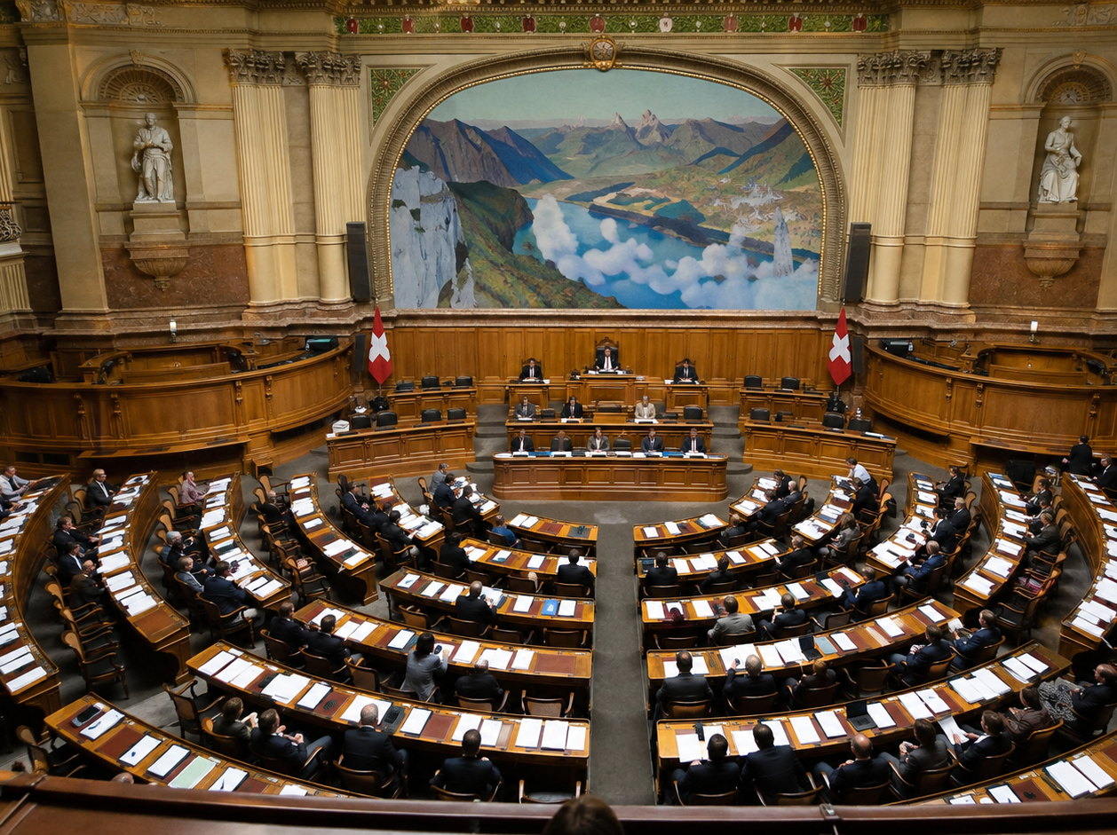
The National Council: the “People’s Chamber”
The larger chamber of the Federal Assembly
200
representatives of the People
Direct election
by eligible Swiss voters
26 constituencies
each canton is an electoral constituency
Population based
but every canton has at least 1 seat
National Council Chamber • Bern
2023–2027 legislature
Federal Constitution, Art. 149; official Swiss Parliament. Chamber image generated for teaching illustration.
Notes:
Now we move to the National Council. This is the chamber that represents the people. It has 200 members. Every canton is one electoral constituency. Larger cantons receive more seats because allocation follows population, but even the smallest canton is guaranteed one seat. The present legislature is the 2023–2027 period.

Slide 9
Composition: population matters — but small cantons are protected
Current and forward-looking facts
200 seats are redistributed among the 26 cantons according to resident population; allocation is reviewed every four years.
Largest current delegation
36 seats
Smallest cantons
1 seat
range in the current allocation
constitutional minimum
Approx. representation
≈45,000 people
Fixed chamber size
200
per National Councillor (official guide)
since 1963
Latest 2027 allocation change: Lucerne +1 (10 seats), Fribourg +1 (8); Bern −1 (23), Graubünden −1 (4). Total remains 200.
ch.ch “Number of seats in Parliament” (current page, accessed 31 Aug 2026); Swiss Confederation – A Brief Guide 2024.
Notes:
This is where we should update the older textbook figures. The National Council has had 200 members since 1963. The current allocation ranges from 36 seats in the largest delegation to one seat in the smallest cantons. The official guide gives roughly 45,000 residents per National Councillor. For the 2027 election, seat distribution will change slightly, but the total remains 200.

Slide 10
How is the National Council elected?
Proportional representation in most cantons, majority rule in six single-seat cantons
PROPORTIONAL REPRESENTATION
SIMPLE MAJORITY
Used in the 20 cantons that elect more than one National Councillor.
Used where a canton has only ONE National Council seat:
Simple classroom example
Uri (UR)
Glarus (GL)
Obwalden (OW)
Nidwalden (NW)
Appenzell Ausserrhoden (AR)
Appenzell Innerrhoden (AI)
Party A
40%
≈ 4 seats
Party B
30%
≈ 3 seats
Party C
20%
≈ 2 seats
Party D
10%
≈ 1 seat
Purpose: translate party/list vote shares into seats more proportionately.
PR has been the general National Council principle since 1919.
Federal Constitution, Art. 149; ch.ch election procedures; Swiss Parliament official guide.
Notes:
The key rule is easy. If a canton has several National Council seats, proportional representation is used. Party or list strength helps determine how many seats each receives. If a canton has only one seat, proportional representation is impossible, so the candidate with the highest vote wins. The six one-seat cantons are Uri, Glarus, Obwalden, Nidwalden and the two Appenzells.

Slide 11
Who can vote and who can become a National Councillor?
Modern rules — with one important historical note
CURRENT RULES
HISTORICAL MILESTONE
Swiss citizens aged 18 or above can vote at federal level.
A person eligible to vote may be elected to the National Council.
Members are directly elected by the people.
Constitutional incompatibility: a member cannot simultaneously sit in another of the National Council, Council of States, Federal Council or Federal Supreme Court.
1971
Women obtained voting and electoral rights at the federal level.
Teaching note: older texts may list restrictions that have since been reformulated. For exams, prefer the current constitutional rule on eligibility and incompatibility.
Federal Constitution, Arts. 136, 143–144; Swiss Parliament historical materials on women’s suffrage.
Notes:
For current answers, keep the rule simple: Swiss citizens aged eighteen and above have federal voting rights, and anyone eligible to vote may be elected to the National Council. Article 144 prevents simultaneous membership of certain highest federal bodies. Also remember 1971, when women obtained federal voting and electoral rights. This is an important historical correction to older descriptions of Swiss democracy.

Slide 12
Tenure, sessions, quorum and voting
How the National Council conducts its work
4 years
Term of office
General election every four years.
4 ordinary sessions
Spring • Summer • Autumn • Winter
Normally three weeks each.
Extraordinary session
Possible when constitutionally requested
Federal Council or one-quarter of either Council may request it.
Quorum
Majority of members must be present
For a 200-member chamber: at least 101 present.
Decision
Usually majority of those voting
Special matters may require an absolute majority of all members.
2026 autumn session: 14 Sep – 2 Oct
Federal Constitution, Arts. 145, 151, 159; Swiss Parliament 2026 session schedule.
Notes:
The National Council is elected for four years. Parliament normally meets four times each year—spring, summer, autumn and winter—and these ordinary sessions usually last three weeks. The 2026 autumn session runs from 14 September to 2 October. The Council has a quorum when a majority of members is present; with 200 members, that means at least 101.

Slide 13
Debates and the President of the National Council
Orderly proceedings, public scrutiny and a rotating presidency
DEBATES
PRESIDENT
Proceedings are public unless law provides an exception.
Debates are broadcast live and statements are available through the Official Bulletin.
Speaking is governed by procedural rules; members register to speak in many debates.
The Swiss style is often described as business-like and less theatrically adversarial than Westminster practice.
Elected from among National Council members for one year.
A first and second Vice-President are also elected.
Immediate re-election as President for the next year is not permitted.
Presides over debates, maintains order and represents the Council.
2025/26 President: Pierre-André Page
Federal Constitution, Arts. 152, 158; official National Council page and Official Bulletin information (accessed 31 Aug 2026).
Notes:
Swiss parliamentary debates are public and can be followed live. The Official Bulletin provides transcripts and videos. The President is elected for one year, supported by two vice-presidents, and cannot simply remain President in the following year. As of the 2025–26 parliamentary year, Pierre-André Page is President of the National Council.

Slide 14
Why is there “no official opposition” in the Swiss Parliament?
A major difference from the British Westminster model
WESTMINSTER MODEL
SWISS CONSENSUS MODEL
Government benches
Official Opposition
SVP
SP
Centre
FDP
Greens
GLP
Political contest is organised around government vs opposition.
No single majority or permanent “His Majesty’s Opposition” equivalent. Coalitions and majorities vary issue by issue.
Bryce: “There is no bench for a Ministry nor for an Opposition...”
Federal Chancellery, Swiss Confederation – A Brief Guide 2024; Bryce quotation from supplied textbook extract.
Notes:
This is one of the most exam-worthy features. In the United Kingdom, we think in terms of government benches and an official opposition. Switzerland is different. Its politics is consensual and multi-party. There is no single permanent opposition party with the same constitutional and symbolic status as in Westminster. Majorities can change from issue to issue.

Slide 15
Do not copy outdated textbook facts without updating them
What to retain — and what to correct
RETAIN
Federal Assembly is bicameral; two chambers are equal.
Still constitutionally correct.
RETAIN
Direct democracy limits parliamentary finality.
Still a defining feature.
UPDATE
“About 22,000 people per member.”
Current official guide: roughly 45,000 per National Councillor.
UPDATE
Old references to changing House strength.
National Council has been fixed at 200 since 1963.
UPDATE
Older eligibility restrictions stated in broad terms.
Use current Arts. 143–144: eligibility + incompatibility.
CONTEXTUALISE
“Advisory body” language.
A scholarly interpretation, not the literal constitutional status.
Exam strategy: show the classical concept, then add one line of updated constitutional/current information.
Notes:
This slide is especially important because your textbook contains older demographic and institutional details. We should retain the conceptual discussion, including the scholars, but update empirical facts. A strong university answer can say: “Classical scholars emphasised the electorate’s dominance; under the current Constitution, however, Article 148 formally describes the Federal Assembly as the supreme authority subject to the rights of the People and Cantons.”

Slide 16
Exam answer framework: “Discuss the National Council of Switzerland”
A ready-made structure for 8–10 marks
1. Definition
2. Composition
1
2
People’s chamber of the Federal Assembly; 200 members.
Seats allocated among cantons by population; minimum one each.
3. Election
4. Qualification
3
4
Direct election; PR in multi-seat cantons, majority in six one-seat cantons.
Swiss citizens 18+ may vote; eligible voters may stand; incompatibility rules apply.
5. Tenure & sessions
6. Presidency & debates
5
6
Four-year term; four ordinary sessions annually; quorum = majority.
President for one year; public, rule-governed proceedings.
7. Distinctive feature
8. Scholar line
7
8
Equal bicameralism + direct democracy + no Westminster-style official opposition.
Use Codding or Rappard, then critically relate it to Article 148.
Finish with a 2-line analytical conclusion
Notes:
For a long answer, follow this sequence. Do not jump randomly from one fact to another. Begin with definition and composition, then election, qualification, tenure, sessions, presidency and debates. Finally, add what makes the Swiss case distinctive: equal bicameralism, direct democracy and the absence of a Westminster-style official opposition. A scholar quote works best near the conclusion, not as a substitute for facts.

Slide 17
Quick recap + likely exam questions
Use this slide for the last five minutes of class
✓
Federal Assembly
246 members; 200 + 46; equal chambers.
✓
National Council
represents the People; 200 seats; direct election.
✓
Election
PR in 20 multi-seat cantons; majority in 6 one-seat cantons.
✓
Direct democracy
Parliament is supreme subject to People and Cantons.
✓
Swiss distinctiveness
consensus politics; no Westminster-style official opposition.
Likely questions
1) Describe the composition and election of the National Council. 2) Explain the constitutional position of the Federal Assembly. 3) Why is there no official opposition in Switzerland? 4) Discuss how direct democracy limits parliamentary supremacy.
Notes:
Before ending the class, ask students to answer orally: Who does the National Council represent? How many members? Why are the chambers equal? What happens in a one-seat canton? And why does Codding call Parliament advisory-like? These quick questions reveal whether the basic conceptual structure is clear.

Slide 18
Sources and further reading
Primary and official sources used for the updated facts
Federal Constitution of the Swiss Confederation — Arts. 136, 141, 143–169, 193.
Swiss Parliament (parlament.ch) — National Council, parliamentary groups, committees, sessions and Official Bulletin.
Swiss Confederation / Federal Chancellery — The Swiss Confederation: A Brief Guide 2024.
ch.ch — Procedures for election of the National Council; Number of seats in Parliament.
About Switzerland (FDFA) — Political system, updated 29 April 2026.
Textbook extract supplied by the instructor — scholarly quotations from Codding, Rappard and Bryce.
Teaching note: statistical and office-holder facts were checked against official Swiss sources on 31 August 2026.
Notes:
These are the sources behind the updated version of the lecture. For students, the most important primary source is the Federal Constitution, especially Articles 148 to 159 for organisation and procedure, and Articles 163 to 173 for powers.

