Slide 1


TYPES OF FEMINISM
A Comprehensive Theoretical Analysis of Feminist Schools of Thought

Slide 2
Evolution & Taxonomy
Feminism is not a monolithic ideology, but a dynamic spectrum of theories, methodologies, and socio-political critiques addressing gendered power structures.

Slide 3

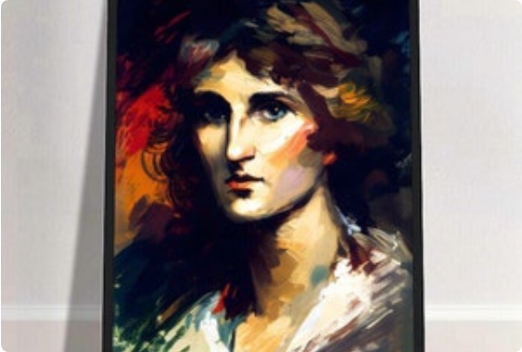
1. Liberal Feminism
Reformist Equality & Individual Rights
•
Core Premise: Gender inequality is rooted in legal, educational, and institutional barriers rather than systemic structures.
•
Strategy: Rational reform, legislative policy amendments, political suffrage, and equal opportunity within the democratic system.
•
Key Thinkers: Mary Wollstonecraft (A Vindication of the Rights of Woman), John Stuart Mill, Betty Friedan (The Feminine Mystique).
•
Critique: Often accused of white, bourgeois individualism that fails to critique deeper patriarchal-capitalist structures.

Slide 4


2. Radical Feminism
Patriarchy as Fundamental Root
Dismantling Systems & Sexuality
Asserts that patriarchal power is the primary, most fundamental form of social oppression, pre-dating capitalism and class divisions.
Rejects reformism; demands radical restructuring of society, marriage, nuclear family institutions, and reproductive dynamics.
Key Theorists: Kate Millett (Sexual Politics), Shulamith Firestone (The Dialectic of Sex), Andrea Dworkin.
Famous slogan: "The Personal is Political" (Carol Hanisch), highlighting how private domain dynamics reflect public power.

Slide 5
3. Marxist & Socialist Feminism
Marxist Feminism (Class Priority)
Socialist Feminism (Dual-Systems)
Identifies capitalism as the primary source of female oppression. Women's unpaid domestic labor is analyzed as essential social reproduction that subsidizes capitalist capital accumulation.
Combines Marxist class critique with Radical feminist patriarchal critique, arguing capitalism and patriarchy operate as co-constitutive, interlocking oppression systems.
Key Text: Friedrich Engels' The Origin of the Family, Private Property and the State.
Key Theorists: Heidi Hartmann, Juliet Mitchell, Sheila Rowbotham.

Slide 6





4. Psychoanalytic & Existentialist
Psychoanalytic
Existentialist
Care Ethics
Re-evaluates Freudian concepts of unconscious psychosexual development, mothering roles, and gender socialization.
Examines woman as constructed into the passive "Other" relative to the male essential Subject.
Challenges masculine moral philosophy by foregrounding relational ethics, empathy, and interdependence.
Theorists: Nancy Chodorow, Luce Irigaray.
Key Text: Simone de Beauvoir's The Second Sex ("One is not born, but rather becomes, a woman").
Key Theorist: Carol Gilligan (In a Different Voice).

Slide 7

5. Intersectional & Black Feminism
Matrix of Interlocking Oppressions
•
Concept: Coined by Kimberlé Crenshaw (1989) to explain how race, gender, class, and sexuality intersect continuously.
•
Critique: Rejects the universalization of white, middle-class female experience as representative of all women.
•
Matrix of Domination: Formulated by Patricia Hill Collins to describe intersecting structural power vectors.
•
Pioneers: Combahee River Collective, bell hooks, Audre Lorde, Angela Davis.

Slide 8
6. Poststructural & Postmodern
Gender Performativity
Écriture Féminine & Language
Deconstructs essentialist gender identity. Asserts gender is not an internal essence but an ongoing, reiterated sequence of performative acts structured by discursive norms.
Critiques phallogocentric language structures. Promotes French feminist concepts of "feminine writing" to disrupt binary patriarchal discourse.
Key Text: Judith Butler's seminal work Gender Trouble (1990).
Key Theorists: Hélène Cixous (The Laugh of the Medusa), Julia Kristeva, Jacques Derrida's influence.

Slide 9
7. Postcolonial & Subaltern Feminism
De-centering Western Hegemony
Double Colonization & Subalternity
Critiques Western feminists for paternalistically constructing the homogenized, passive "Third World Woman" subject without historical specificity.
Investigates how women in Global South nations experience "double colonization"—oppressed simultaneously by imperialist forces and native patriarchies.
Key Essay: Chandra Talpade Mohanty's Under Western Eyes (1984).
Key Theorists: Gayatri Chakravorty Spivak (Can the Subaltern Speak?), Trinh T. Minh-ha.

Slide 10

8. Ecofeminism
Nature & Gender Interconnections
Ecofeminism draws explicit parallels between the patriarchal exploitation of women and the capitalist degradation of the natural environment.
It posits that dualistic, hierarchical worldviews (Culture/Nature, Male/Female, Reason/Emotion) justify structural domination.
Prominent Theorists: Vandana Shiva (Staying Alive), Maria Mies, Karen Warren.

Slide 11





9. Cyber & Transfeminism
Cyberfeminism
Transfeminism
Fourth-Wave Digital
Explores technology, cyberspace, and virtual identity as sites to transcend binary gender limitations.
Integrates trans experience into feminist theory, advocating bodily autonomy and self-determination against cissexism.
Utilizes networked digital platforms (#MeToo) for global solidarity, anti-harassment, and rapid coalition building.
Donna Haraway's A Cyborg Manifesto; VNS Matrix.
Julia Serano (Whipping Girl), Emi Koyama.
Digital praxis & public sphere discourse.

Slide 12
Questions & Dialogue
Towards a pluralistic, critical feminist praxis in contemporary literary and cultural studies.

Slide 13



Image Sources
https://i.etsystatic.com/29572990/c/701/701/49/48/il/d03192/5710123179/il_300x300.5710123179_2jbo.jpg
Source: www.etsy.com
https://www.law.columbia.edu/sites/default/files/2020-02/kimberle_crenshaw.jpg
Source: www.law.columbia.edu
https://ik.imagekit.io/theartling/prod/products/Product/2159152d106f4071babac16d1fe51457_sw-2540_sh-2113.jpg
Source: theartling.com

