Slide 1

Ziauddin Barani’s Ideal Polity
A Critical Analysis of Statecraft, Kingship, Shariat, and Zawabit in 14th-Century Medieval India

Slide 2
Historical Context & Background
Ziauddin Barani (1285–1357 CE) lived through the reigns of Balban, Alauddin Khalji, Muhammad bin Tughlaq, and Firoz Shah Tughlaq during the Delhi Sultanate.

Slide 3


Core Texts of Barani’s Thought
Fatawa-i-Jahandari
Tarikh-i-Firoz Shahi
"Edicts of World Rule" (c. 1357): Formulated as 24 Nasihat (advices) delivered by Sultan Mahmud of Ghazni. It is the only dedicated Indo-Persian treatise on political theory and Islamic statecraft from the Delhi Sultanate.
Historical Chronicle: Offers a detailed narrative of the Delhi Sultans from Balban to Firoz Shah Tughlaq. It serves as the empirical counterpart to his political theory, illustrating how Sultans governed in practice.

Slide 4
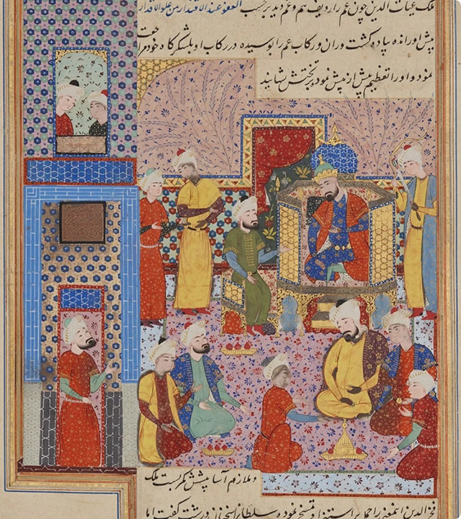
Dual Role of the Sultan
Religious Agent & Political Realist
Barani conceptualizes the Sultan as the "Shadow of God" (Zill-Allah) on Earth, tasked with implementing divine order.
He makes a vital distinction between the Sultan's personal piety and public administration. In governance, political firmness and administrative expediency must prevent chaos and rebellion.

Slide 5






Pillars of Barani’s Ideal Sultan
Noble Birth
Firm Will (Azm-i Durust)
Political Acumen
Believed governance requires inherited nobility. He fiercely opposed the appointment of "low-born" individuals to high administrative offices.
Requires decisive, unwavering determination to execute state policies without hesitation or paralysis from court intrigue.
Must possess deep wisdom, foresightedness, and the ability to detect deceptions and conspiracies within the royal court.

Slide 6
Sources of Law: Shariat & Zawabit
Shariat (Religious Law)
Zawabit (State Regulations)
Represents the divine Islamic legal foundation. Barani asserts that the primary objective of a Muslim monarch is to protect Islam and enforce fundamental religious duties in society.
Secular, pragmatic state laws enacted by the Sultan to address complex political situations not explicitly covered by the Shariat. Barani acknowledged that Zawabit could temporarily override religious law for state survival.

Slide 7

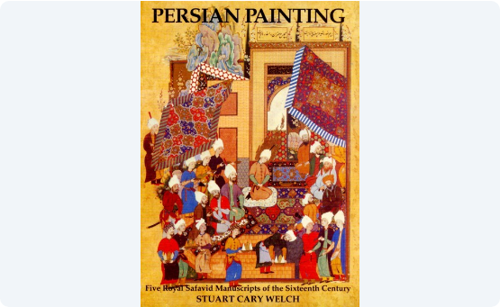
Concept of Justice (Adl) & Class Order
•
Protection of the Weak: For Barani, justice (Adl) means protecting the vulnerable from oppression by the powerful.
•
Preservation of Hierarchy: Justice also meant maintaining fixed social stations. Society was naturally divided into aristocrats and commoners.
•
Opposition to Social Mobility: Barani viewed education for lower classes as dangerous, fearing it would undermine administrative stability.
•
Balance of Mercy & Force: The ruler must combine fear, terror, and punishment with measured forgiveness.

Slide 8
Practical Statecraft Manual
Indo-Persian Realism
24
In Fatawa-i-Jahandari, Barani presents 24 distinct strategic counsels covering price control, army maintenance, espionage, judicial appointments, and diplomatic defense.
Due to its emphasis on political expediency, state survival, and power dynamics, scholars frequently compare Barani's treatise to Kautilya's Arthashastra and Machiavelli's The Prince.
Nasihat (Advices) for Kings

Slide 9

Comparative Law Framework
Dimension | Shariat (Religious Law) | Zawabit (State Laws)
Origin | Divine Revelation & Prophetic Tradition | Sultan's Royal Decree & Wisdom
Scope | Universal Moral & Spiritual Duties | Administrative Expediency & Public Order
Flexibility | Rigid & Unchangeable | Dynamic, Adaptable to Context
Conflict Rule | Ideal Spiritual Authority | Praxis: Overrides Shariat in crises

Slide 10



Four Pillars of Administrative Governance
2. Nobility Control
4. Justice & Order
Exclusive recruitment of aristocratic elites in state bureaucracy.
Enforcement of firm punishment to deter rebellion and oppression.
1. Royal Legitimacy
3. State Law (Zawabit)
Establishment of divine sanction and elite lineage for authority.
Implementation of pragmatic ordinances to safeguard the realm.

Slide 11
Barani’s Core Thesis
"Monarchy is indispensable to prevent anarchy, but without justice, noble counsel, and state regulations, royal power degenerates into mere tyranny."
"
— Summary of Fatawa-i-Jahandari
"

Slide 12
Questions & Discussion
A complex synthesis of Islamic orthodoxy, aristocratic conservatism, and political realism.

Slide 13


Image Sources
https://api.qalam.global/storage/media/r/1000x-/cd279826-3c44-43b1-9c3d-3c8c267ffd14.webp
Source: qalam.global
https://i.ebayimg.com/images/g/tBoAAOSwMtxXuCoB/s-l1200.jpg
Source: www.ebay.com

