Slide 1

MA GENDER STUDIES • 3RD SEMESTER
Comprehensive Course Presentation
An Interdisciplinary Examination of Sex, Gender, Patriarchy, Socialization, and Legal Rights Frameworks

Slide 2

Foundational Concepts
Deconstructing the distinction between biological sex and socially constructed gender roles

Slide 3
Conceptual Framework: Sex vs. Gender
Analytical Dimension | Sex | Gender
Category Type | Biological category assigned at birth | Social and cultural category learned over time
Primary Determinants | Chromosomes, hormones, and anatomical structures | Roles, norms, behaviors, and cultural expectations
Universality & Variation | Relatively universal across human populations | Varies significantly across societies and history
Illustrative Example | Only females can biologically become pregnant | Expectation that only women should care for children

Slide 4


Key Feminist Scholars & Theorists
Simone de Beauvoir: Formulated "One is not born, but rather becomes, a woman," detailing society's role in shaping femininity.
Ann Oakley: Established clear sociological boundaries distinguishing biological sex from social gender.
Judith Butler: Pioneered Gender Performativity—gender as acts continually constructed through language and gesture.
Sylvia Walby: Conceptualized patriarchy operating through 6 structures (household, work, state, violence, sexuality, culture).
Naila Kabeer & Bina Agarwal: Linked empowerment to resources, strategic agency, and land ownership rights.

Slide 5




The Process of Gender Socialization
2. School & Peers
4. Workplace
Reinforces normative behavior; peer rewards for conformity to gender roles.
Institutionalized gender identity and occupational role segregation.
1. Family
3. Media & Culture
First lessons in gender; primary toy, color, and emotional expectations assigned.
Normalizes stereotypes and defines cultural beauty or behavioral standards.

Slide 6

Structural Impact of Gender Stereotyping
Systemic Consequences of Norms
6
Gender stereotypes create oversimplified assertions (e.g., "men are leaders", "women are naturally caring") that limit full human potential across spheres:
•
Discourages female participation in STEM disciplines.
Structures of Patriarchy (Walby)
•
Suppresses emotional expression in young boys.
•
Maintains the "glass ceiling" in corporate leadership.

Slide 7
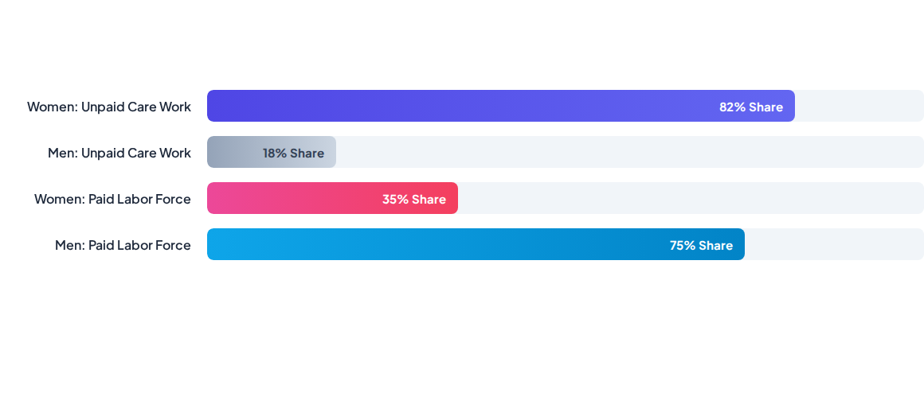
Gender Division of Labour: Care Economy
Unpaid domestic and care work performed predominantly by women sustains the formal economy, yet remains invisible in national accounting and economic metrics.

Slide 8






Major Feminist Theoretical Perspectives
Liberal Feminism
Marxist & Radical
Intersectional
Advocates for gender equality through legal reforms, constitutional guarantees, and equal educational and workplace opportunities.
Marxist views highlight unpaid labor sustaining capitalism; Radical views identify patriarchy as the primary source of oppression.
Framed by Kimberlé Crenshaw; analyzes how gender intersects with caste, class, race, religion, and disability structures.

Slide 9

Gender & Justice in India
Constitutional & Policy Safeguards
Constitutional Mandates: Articles 14 (Equality), 15 (Non-discrimination), 16 (Equal opportunity), 39(d) (Equal pay), and 42 (Maternity relief).
Policy Frameworks: Direct initiatives such as Beti Bachao Beti Padhao, Self-Help Groups (SHGs), Maternity Benefit Act, and 33% reservations in local self-government.

Slide 10


Contemporary Debates & Frontiers
Non-Binary & Queer Rights
Care Economy & Digital Divide
Deconstructing rigid gender binaries and recognizing LGBTQ+ rights, bodily autonomy, and performative identities beyond traditional legal frameworks.
Addressing the digital gender divide, enacting gender-responsive budgeting, and recognizing reproductive rights within social security policies.

Slide 11
Key Academic Review Questions
Question 1: Distinguish between sex and gender with suitable examples and scholarly views.
Question 2: Explain the process of gender socialization and analyze its primary institutional agents.
Question 3: Discuss the gender division of labour utilizing Marxist and Radical feminist perspectives.
Question 4: Critically evaluate Judith Butler's concept of gender performativity in modern context.

Slide 12

Thank You
Questions & Discussion
Presented by: Barnika Devi

Slide 13


Image Sources
https://res.cloudinary.com/bloomsbury-atlas/image/upload/w_568,c_scale,dpr_1.5/jackets/9781472529220.jpg
Source: www.bloomsbury.com
https://www.scobserver.in/wp-content/uploads/2024/06/RAHELA-Final-1-scaled.jpg
Source: www.scobserver.in

