Slide 1


ANCIENT JURISPRUDENCE & GOVERNANCE
Manu's Social Laws
A Structural Analysis of Manusmriti, Dharma, and the Ancient Indian Legal Framework

Slide 2

INTRODUCTION
Origins & Textual Foundation
Composed between 200 BCE and 200 CE, the Manusmriti (Mānava-Dharmaśāstra) comprises approximately 2,685 Sanskrit verses across 12 chapters, articulating a comprehensive code for societal order.

Slide 3


Dharma & Four Sources of Law
The Centrality of Dharma
The Fourfold Sources of Law
In Manusmriti, Dharma is the foundational cosmic and moral order. It encompasses ethical duties, social obligations, righteousness, and legal norms governing individual and collective life.
Manu identifies four distinct authorities for defining legal and moral conduct:
•
Veda: Sacred revelation and primary divine source.
•
Smriti: Sacred tradition and texts handed down by sages.
The text operates on the premise that strict adherence to individual duty (Svadharma) preserves harmony across the universe and human society.
•
Sadachara: Virtuous conduct and customs of noble people.
•
Atmatusti: Inner conscience and personal satisfaction of the righteous.

Slide 4

The Varna System & Hierarchy
Fourfold Social Stratification
Manu codifies society into four functional inherited classes (Varnas), assigning hereditary duties to maintain social order:
•
Brahmins (Priests/Scholars): Studying, teaching Vedas, conducting rituals, and providing moral guidance.
•
Kshatriyas (Rulers/Warriors): Protecting citizens, waging righteous war, and administering justice.
•
Vaishyas (Merchants/Farmers): Trade, agriculture, cattle rearing, and wealth generation.
•
Shudras (Laborers): Service to the upper three varnas and manual labor.

Slide 5






The Four Ashramas of Life
1. Brahmacharya
2. Grihastha
3. Vanaprastha
4. Sannyasa
Student Stage: Dedicated to education, celibacy, discipline, and acquiring Vedic knowledge under a teacher (Guru).
Householder Stage: Family life, earning wealth (Artha), experiencing desire (Kama), and fulfilling social duties.
Forest Dweller Stage: Gradual withdrawal from material pursuits, retirement, reflection, and spiritual study.
Renunciate Stage: Total detachment from worldliness, asceticism, meditation, and pursuit of liberation (Moksha).

Slide 6

Rajadharma & Governance
Statecraft & Dandaniti
18
Manusmriti devotes nearly 1,000 verses to Rajadharma (the duties of a king), framing political power as a sacred trust to protect subjects and enforce law.
Danda (Coercive Justice): The king uses punishment to prevent anarchy (Matsyanyaya or 'law of the fish'). Manu defines 18 titles of law including contract non-performance, property disputes, theft, assault, and defamation.
Grounds for Litigation

Slide 7

Law, Justice & Punishment
Varna Class | Primary Duty (Svadharma) | Legal Standing | Penal Approach (Danda)
Brahmin | Teaching, Rituals, Guidance | Highest immunity; spiritual authority | Penance, fines, public dishonor; exempt from capital punishment
Kshatriya | Protection, Statecraft, War | High status; executive authority | Heavy fines and banishment for abuse of power
Vaishya | Agriculture, Commerce, Trade | Standard civil protection | Financial restitution and proportional fines
Shudra | Service & Labor | Restricted legal rights | Harsher physical punishments for transgressions against upper castes

Slide 8
Family, Marriage & Property
Household Organization
Family is viewed as the cornerstone of social stability. Manusmriti outlines patriarchal authority where the household head manages rituals and property.
Forms of Marriage: The text categorizes 8 forms of marriage, praising righteous unions based on mutual consent and condemning coercive rites.
Inheritance: Property passed down through patrilineal succession, emphasizing primogeniture while outlining specific conditions for stridhana (women's property).

Slide 9
Gender Norms & Women's Role
Domestic Veneration: Verse 3.56 famously states, "Where women are honored, there the gods rejoice," emphasizing domestic respect and protection within the family unit.
Lifelong Guardianship: Dictates that a woman must be protected by her father in childhood, her husband in youth, and her sons in old age, denying formal independence.
Educational & Ritual Exclusion: Restricts women from independent Vedic study, sacred initiation rituals (Upanayana), and autonomous fire sacrifices.
Marital Fidelity & Remarriage: Strongly emphasizes ideal devotion (Pativrata) while generally disapproving of widow remarriage.

Slide 10




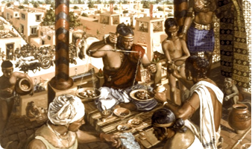

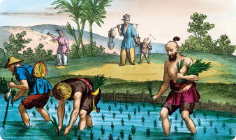

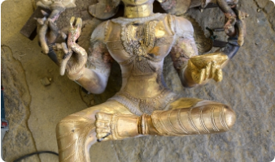
Economic & Occupational Law
Trade & Commerce
Land & Agriculture
Apad-Dharma Rules
Regulations for Vaishyas detailing price controls, standardized weights and measures, market taxation, and fair interest rates for lending.
Laws governing land ownership, boundary disputes between villages, crop taxation by the king, and protection of agricultural livestock.
Emergency rules permitting individuals to adopt occupations of adjacent classes during severe economic distress or famine.

Slide 11
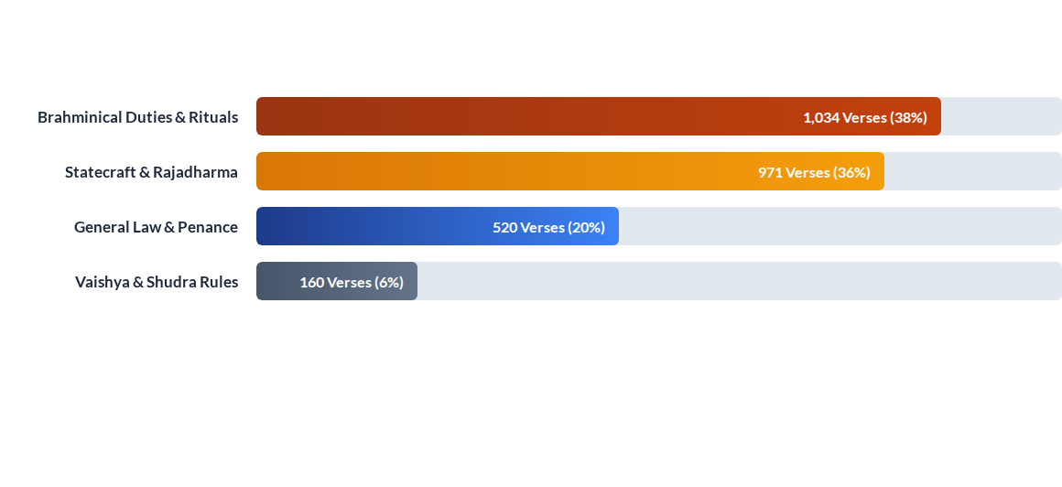
Distribution of Textual Laws

Slide 12
Modern Reassessment
From Colonial Codification to Contemporary Critiques
Translated in 1776 by Sir William Jones for East India Company courts, Manusmriti was elevated beyond its historical context. In modern times, thinkers like Dr. B.R. Ambedkar critiqued its institutionalization of caste and gender inequality, making it a pivotal text in discussions on social justice and modern legal reform.
Thank You | Questions & Discussion

Slide 13





Image Sources
https://upload.wikimedia.org/wikipedia/commons/9/98/An_Ancient_Meitei_language_palm_leaf_manuscript_text_-_in_traditional_Old_Meetei_Mayek_writing_system.jpg
Source: en.wikipedia.org
https://upload.wikimedia.org/wikipedia/commons/6/6b/12th-century_stone_carving_showing_Nataraja_legend_at_Shaivism_Hindu_temple_Hoysaleswara_arts_Halebidu_Karnataka_India_4.jpg?utm_source=commons.wikimedia.org&utm_campaign=index&utm_content=original
Source: commons.wikimedia.org
https://storage.ghost.io/c/7a/28/7a282001-d7d9-4557-89df-49e915555c31/content/images/local/2022-06/c3e6ab77-3519-4d3a-8ccc-ed0e0f29dd7c/Guilds_Ancient_India.jpeg
Source: www.dharmadispatch.in
https://oryzoindia.com/wp-content/uploads/2021/10/History-of-Rice-1024x595.webp
Source: oryzoindia.com
https://cdn.sanity.io/images/k7aa4gdi/production/f1060ac8f1a3a28606a64c1c64ae4d58f9050519-682x1024.jpg?q=100&fit=max&auto=format
Source: coonoorandco.com

