Slide 1
History of the Swiss Constitution
Digital Material designed by Dr. Parismita Bhagawati for Unit IV of the Semester: 5th Semester
Course Name: POL050304: Comparative Government and Politics

Slide 2
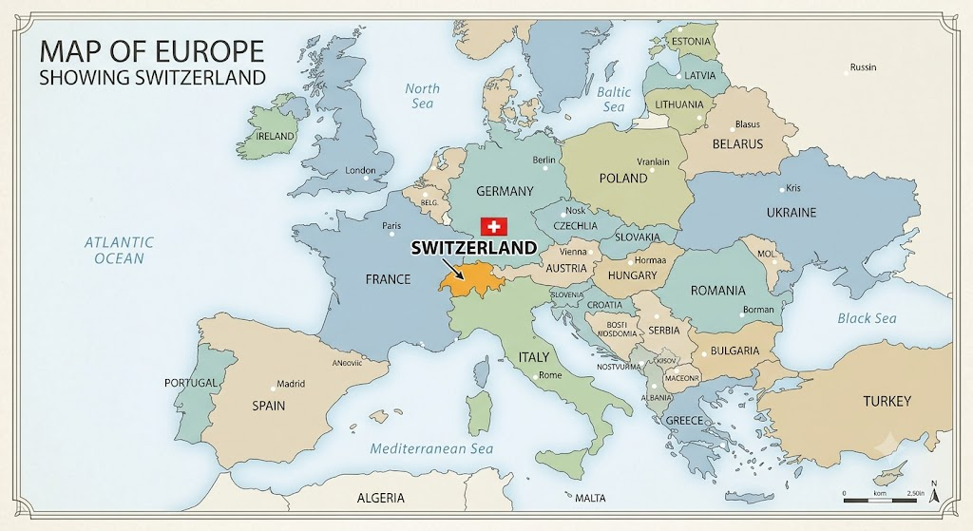

Slide 3
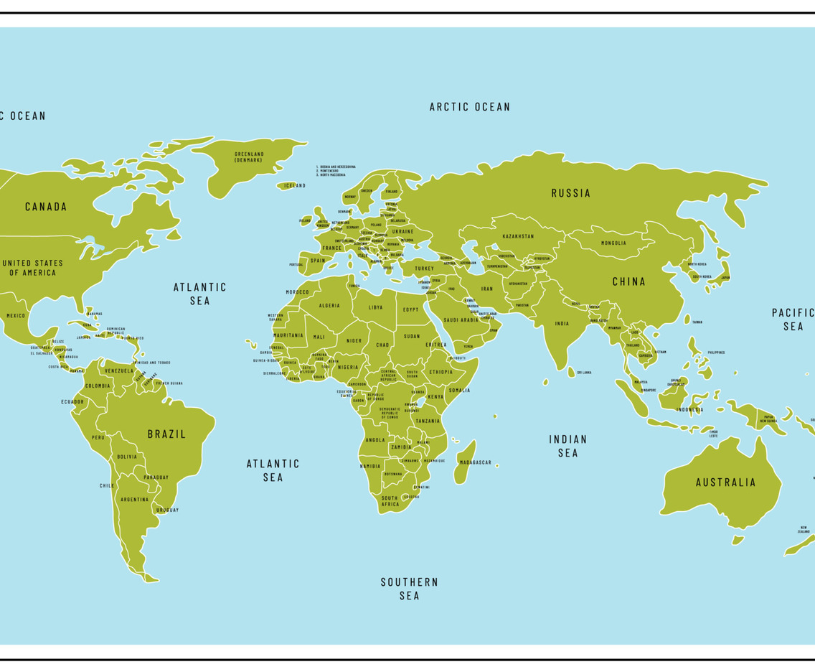

Slide 4
Historical Milestones & Origins
1291 (The Foundation): Three cantons (Uri, Schwyz, Unterwalden) signed the Everlasting Alliance to protect local autonomy against Habsburg expansion.
Origins of the Name: The name Switzerland originates directly from the central founding canton of Schwyz.
1499–1648 (Independence): Achieved de facto independence from the Holy Roman Empire after the Swabian War (1499); legally recognized in the Peace of Westphalia (1648).
1848 (Modern State): Transformed from a loose confederation into a federal nation-state with a constitution balancing central governance and cantonal autonomy.

Slide 5
1999 Revised Swiss Constitution:
Approval & Timeline: Approved via public referendum on April 18, 1999, and took effect on January 1, 2000.
Core Function: Modernized the phrasing and layout of the older 1874 Constitution without changing the government structure or federal system.
Structural Improvements:
  Grouped citizen rights into a dedicated separate section (like most global constitutions).
  Clearly outlined where federal authority ends and cantonal (state) authority begins.

Slide 6
Geography & Borders: Small western European country (about one-third the size of New York state) bordered by Germany (North), France (West), Austria (East), and Italy (South).
Linguistic & Religious Diversity:
Population consists of Germanic, French, and Italian stocks.
Speaks four languages: German (majority), French, Italian, and Romanish (adopted as a national language in 1938).
Religious split includes Protestantism (~one-third) and Catholicism (~one-third).

Slide 7
Direct Democracy & Autonomy:
Built on a 700+ year tradition of self-government.
Cherishes communal/cantonal autonomy and upholds "Direct Democracy" and "Popular Sovereignty".
Recognized by Bryce (Modern Democracies) as the oldest and one of the best true democracies.

Slide 8
Dynamic Neutrality:
Described by Rappard as "the true palladium of Swiss independence".
Respected by aggressive powers (e.g., Nazi Germany, Fascist Italy) during European wars.
Not driven by timidity, non-violence, or passivity; serves as a channel for diplomacy and humanitarian missions (Hans Huber).
UN Membership (2002): On March 3, 2002, Swiss voters approved joining the United Nations by a 54.6% majority.

Slide 9
Meaning of Permanent Neutrality of Switzerland
No Military Alliances: Cannot join defensive alliances like NATO.
No Direct Armament: Cannot send its own military forces to a war zone or supply weapon systems directly to a warring party.
No Troop Movement: Cannot allow warring nations to use its territory, airspace, or waterways to move troops or weapons.
Equal Treatment: Must treat belligerent states equally in military matters (e.g., if it closes its airspace to one fighting nation, it must close it to the other).
Self-Defense Ability: Must maintain a credible military capable of defending its own borders so another country doesn't invade and use its territory as a battleground.

Slide 10
Because neutrality is military rather than moral or political, a neutral state is free to take a stand in almost every other area:
Moral & Political Stance: A neutral country can condemn an aggressor, vote against them in the United Nations, or call out human rights violations. Neutrality does not require a country to pretend there is no right or wrong.
Economic Sanctions: A neutral nation can choose to adopt economic sanctions against an aggressor state, freeze assets, or halt commercial trade, because sanctions are political and economic tools, not acts of war.
Humanitarian & Financial Aid: A neutral state can freely provide billions in financial support, medical assistance, civilian supplies, and reconstruction aid to a country under attack.

Slide 11
History of the Swiss Constitution in Details

Slide 12
Old Confederation:
Origins & Resistance (1291): Unification began in 1291 when three cantons—Uri, Schwyz, and Unterwalden—formed a Confederation to protect their liberties and resist Austrian Habsburg domination. Before this, Switzerland consisted of separate, uncoordinated cantons subservient to Austrian rule.
Expansion & International Recognition (1353–1648): Encouraged by defeating Habsburg feudal attempts, membership expanded to 8 cantons by 1353 and 13 by 1648, when the Treaty of Westphalia officially recognized Switzerland as a sovereign state.

Slide 13
French Rule & The Act of Mediation (1798–1803): Revolutionary French armies invaded Switzerland, replacing the loose confederation with a centralized French protectorate. Popular resentment against this unitary structure forced Napoleon to restore cantonal autonomy in 1803 via the Act of Mediation.
Reorganization & Territorial Growth (1803–1815): The French period expanded membership by adding 6 cantons under the Act of Mediation and 3 French-speaking cantons in 1815 following the Congress of Vienna, establishing Switzerland's present geographical configuration and trilingual status.

Slide 14
Ideological Struggle & The Sonderbund War (1815–1847): Conflict escalated between Radicals (favoring central authority and unification) and Federalists (favoring cantonal autonomy). This culminated in 1847 when seven Catholic cantons formed a breakaway league ("Sunderband").
Establishment of the Modern Federal State (1848): The defeat of the secessionist Catholic cantons in the 1847 Civil War led to a new constitutional project, which became the organic federal law of Switzerland in 1848, completing the unification process.

Slide 15
Constitution of 1848
Drafting & Ratification: Drafted by a Diet Committee of fourteen, approved by the Diet, and ratified by an overwhelming majority of the cantons and the public via referendum.
Transition to Federal State: Transformed Switzerland from a loose confederation into a unified Federal State.
Compromise on Sovereignty: Represented a compromise arrangement where cantons retained their sovereignty in all matters not explicitly restricted by the Federal Constitution.
Key Institutional Provisions: Established foundational democratic institutions, including a bicameral Federal Assembly, a collegial executive, popular referendum, initiative rights, a common Swiss citizenship, and the Federal Tribunal.

Slide 16
Constitution of 1874
Push for Centralisation: Drafted after 26 years under the 1848 Constitution due to growing demand for centralisation, led by Radicals who favored unified laws over cantonal privileges.
Adoption Date: Framed by the Federal Assembly, approved by a strong majority of citizens, and put into operation on May 29, 1874.
Greater Federal Control: Expanded central power significantly, including placing railways under national federal ownership.
Judicial Unification: Enhanced the powers of the Federal Tribunal and completely abolished the separate judicial systems of individual cantons.

Slide 17
Constitution of 1999
Integration of Amendments: Created primarily to integrate roughly 150 partial amendments—most of which had expanded central authority since 1874—into a single, modernized text.
Adoption Timeline: Adopted by the Federal Parliament on December 18, 1998, approved via public referendum on April 18, 1999, and brought into force on January 1, 2000.
Structural Continuity: Updated and restructured the legal text without making radical changes to the federal framework established in 1874.

