Slide 1
Scope of Public Administration
Digital Material designed by Dr. Parismita Bhagawati for Unit I of the paper POL030104: Perspectives on Public Administration (FYUGP 3rd Semester)

Slide 2
1. The POSDCORB View
Advocate: Formulated and popularized by Luther Gulick.
Core Idea: Focuses on the techniques and administrative processes common to all organizational executive functions.
Nature: It is technique-oriented and views public administration primarily through top-down managerial tools.
The 7 Elements of POSDCORB:
P — Planning: Outlining broad objectives and establishing methods to achieve them.
O — Organising: Establishing formal structures of authority, defining roles, and arranging work subdivisions.
S — Staffing: Managing personnel, including recruitment, training, and maintaining favorable working conditions.
D — Directing: Making continuous decisions, issuing orders/instructions, and providing executive leadership.
CO — Coordinating: Interrelating and harmonizing different parts and divisions of the work.
R — Reporting: Keeping executives and subordinates informed through records, research, and inspection.
B — Budgeting: Handling financial planning, accounting, control, and fiscal management.

Slide 3
2. The Subject Matter View (Opposing View)
Core Critique: Emerged as a reaction to POSDCORB, arguing that administrative techniques alone cannot represent the entire scope or core of public administration.
Core Idea: Focuses on the substantive services and specialized functions provided by an agency (e.g., healthcare, defense, education, agriculture).
Nature: It is subject-oriented rather than purely technique-oriented.
Key Arguments Against POSDCORB:
Ignores Specialized Knowledge: Administrative problems vary greatly depending on the field; running a hospital requires different domain knowledge than running a police force.
Tools vs. Substance: POSDCORB provides only the tools (the 'how'), whereas the subject matter provides the substance or actual service rendered (the 'what').
Local POSDCORB: Each functional field shapes its own administrative processes based on its specific requirements.

Slide 4
The Synthesis (How They Complement Each Other)
Both views are not mutually exclusive; they complement each other to form the complete scope of public administration.
Lewis Meriam's Scissors Analogy:
Public administration is like a pair of scissors. One blade is POSDCORB (technique knowledge) and the other blade is Subject Matter (field/domain knowledge). Both blades are necessary for the tool to work effectively.

Slide 5
Applying POSDCORB and the Subject Matter View to Flood Management in Assam demonstrates how generic executive administration meets domain-specific hydrology and geography.
1. The POSDCORB View (Administrative & Operational Execution)
This represents the top-down managerial machinery led by bodies like the Assam State Disaster Management Authority (ASDMA) and District Disaster Management Authorities (DDMAs):
Planning: Formulating state monsoon preparedness plans, disaster mitigation blueprints, and evacuation routes across flood-prone districts.
Organising: Establishing inter-departmental coordination structures involving Revenue, Health, Police, and Water Resources departments.
Staffing: Deploying Aapda Mitra volunteers, National Disaster Response Force (NDRF) teams, State Disaster Response Force (SDRF) personnel, and relief center managers.
Directing: District Commissioners issuing emergency evacuation alerts, relief camp operational protocols, and site directives during peak flood levels.
Coordinating: Harmonizing action between local Panchayati Raj Institutions (PRIs), District Administration, and civil society organizations for seamless relief delivery.
Reporting: Operating real-time situational tracking, issuing daily flood bulletins, and documenting casualty and damage metrics.
Budgeting: Allocating and disbursing funds through the State Disaster Response Fund (SDRF) and central emergency grants.

Slide 6
The Subject Matter View (Substantive & Technical Expertise)
Generic administrative management alone cannot control floods without deep hydrologic, geographical, and ecological expertise specific to the Brahmaputra and Barak basins:
River Dynamics & Sedimentology: Understanding the massive siltation and bed-level rise of the Brahmaputra and its tributaries.
Civil & Hydraulic Engineering: Designing, constructing, and strengthening thousands of kilometers of earthen embankments, dykes, sluices, and anti-erosion revetments (executed by the Water Resources Department & FREMAA).
Geo-Spatial & Early Warning Technology: Using tools like the Flood Early Warning System (FLEWS), hydro-meteorological modeling, and satellite remote sensing to forecast river stage surges.
Ecosystem & Wetland Ecology: Managing natural flood cushions (like beels and natural reservoirs) and riverbank stabilization.

Slide 7
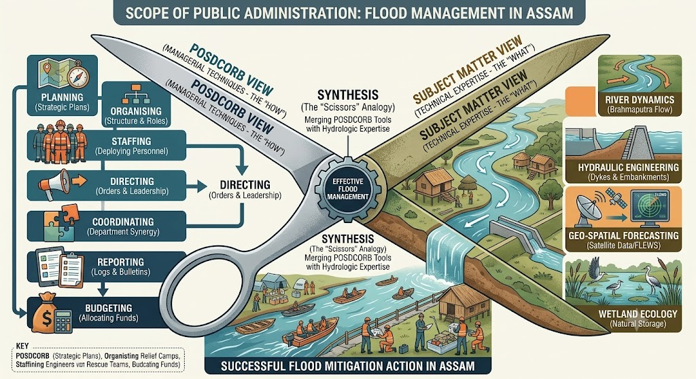

Slide 8
Blade 1 without Blade 2: You have organized relief camps and funded evacuation teams, but if embankments are engineered poorly or constructed in hydrologically unstable zones, the infrastructure collapses.
Blade 2 without Blade 1: Engineers and hydrologists can model exact breach points and river behavior, but without managerial machinery (NDRF/DDMA), nobody mobilizes boats, distributes ration packages, or evacuates citizens.

