Slide 1

Kautilya (Chanakya)
Foundations of Ancient Indian Political Thought, Governance & Statecraft

Slide 2



Historical Context & Life
Political Setting (4th C. BCE)
The Master Strategist
Political Instability: Ancient India faced acute fragmentation across Mahajanapadas, exacerbated by foreign incursions such as Alexander's invasion.
Scholarship: Known as Vishnugupta or Chanakya, he taught political science, economics, and diplomacy at the ancient Takshashila University.
Imperial Foundation: Kautilya engineered the overthrow of the Nanda dynasty, establishing the powerful Mauryan Empire under Chandragupta Maurya.
Practical Realism: Preferred pragmatic governance over abstract idealism, earning him recognition as the Father of Ancient Indian Statecraft.

Slide 3
The Arthashastra Overview
Etymology & Meaning: Derived from 'Artha' (wealth, material prosperity, political power) and 'Shastra' (science/ treatise). It signifies the "Science of Wealth and Statecraft."
Practical Realism: Unlike Plato's idealistic state, Kautilya focused on creating a resilient, stable, prosperous, and secure state guided by empirical realities.
Comprehensive Treatise: Integrates public administration, taxation, criminal justice, military strategy, espionage, and diplomacy into a unified handbook.
Core Objectives: Aims to preserve internal order, foster agricultural and commercial growth, eliminate official corruption, and safeguard sovereignty.

Slide 4
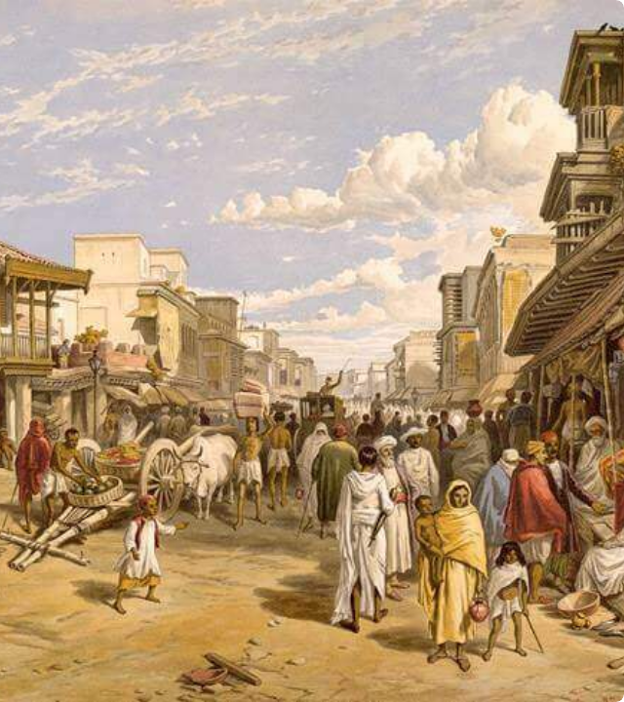
Saptanga Theory
Seven Limbs of the State
Kautilya conceptualized the state as an organic entity composed of seven interdependent organs (Saptangas):
▪
Swami (King): The supreme ruler providing vision and leadership.
▪
Amatya (Ministers): Executive bureaucracy executing administration.
▪
Janapada (Territory/People): Resource base and population.
▪
Durga (Fort): Fortified defenses securing state borders.
▪
Kosha (Treasury): Financial backbone funding state operations.
▪
Danda (Army): Armed forces safeguarding sovereignty.
▪
Mitra (Allies): Strategic external diplomatic partners.

Slide 5
Matsya Nyaya & Kingship
Matsya Nyaya (Law of Fish)
Theory of Kingship
Concept of Anarchy: Without a sovereign government, society devolves into Matsya Nyaya, where the strong exploit and destroy the weak.
Paternal & Welfare Role: The king is the central guardian of the realm. His authority must be exercised with discipline, wisdom, and moral responsibility.
Purpose of the State: The state exists as a legitimate authority to uphold law and order, protect vulnerable citizens, and guarantee social harmony.
Core Dictum: "In the happiness of his subjects lies the king's happiness; in their welfare lies his welfare."

Slide 6






Governance & Dandaniti
Royal Qualities
Royal Duties
Dandaniti
The king must possess intelligence, courage, self-control, and administrative skill. He must strictly avoid greed, luxury, anger, and laziness.
Protects sovereignty, delivers impartial justice, appoints competent officials, regulates trade, collects fair taxes, and upholds Dharma.
Authority and lawful punishment (Danda). Punishment must be proportionate and fair—excessive force breeds revolt, while leniency causes anarchy.

Slide 7
Administrative Structure
Administrative Domain | Key Institutional Mechanism | Core Objective & Function
Bureaucracy & Departments | Superintendents (Adhyakshas) | Centralized & specialized oversight of agriculture, trade, mines, and forests.
Revenue System (Kosha) | Moderate & Fair Taxation | Taxing like a bee gathering nectar; income from land revenue, trade, and custom duties.
Financial Accountability | Audits & Rotations | Preventing corruption by rotating officials, performing audits, and inspecting records.
Public Welfare Infrastructure | State Infrastructure Projects | Building roads, irrigation canals, grain reservoirs, and providing famine relief.

Slide 8
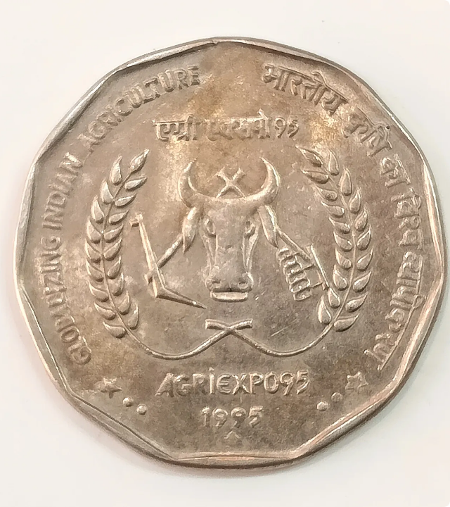
Economy & Welfare State
Economic Foundations
Artha as Priority: Kautilya viewed economic stability as the prerequisite for spiritual (Dharma) and worldly (Kama) accomplishments.
State-Regulated Growth: Agriculture is the main wealth engine, supported by regulated markets, mining, state monopolies, and international trade.
Welfare State Imperative
Duty to Protect: The ruler actively assists orphans, the elderly, sick, and farmers facing droughts or pestilence.

Slide 9

Espionage & Vigilance
Organized Secret Service
Institutionalized Espionage: Kautilya established history's first systematic intelligence organization, deploying secret agents disguised as merchants, ascetics, and scholars.
24/7
Internal Vigilance: Spies gathered public feedback, uncovered conspiracies, and detected administrative corruption early.
State Intelligence Network
Anti-Corruption Maxim: Likened dishonest bureaucrats to "fish swimming in water who drink without being noticed," requiring surprise audits and strict penalties.

Slide 10



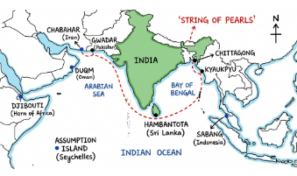
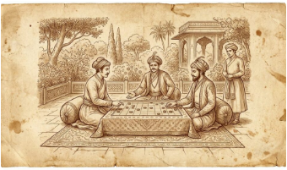
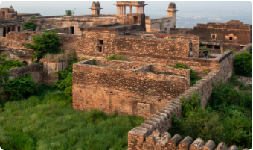
Foreign Policy Framework
Mandala Theory
Shadgunya (6 Measures)
Four Upayas (Tactics)
Circle of States: Immediate neighbours are natural rivals (Ari), while a neighbour's neighbour is a natural ally (Mitra).
Six foreign policy choices: Peace (Sandhi), War (Vigraha), Neutrality (Asana), Marching (Yana), Alliance (Samsraya), Dual Policy.
Diplomatic techniques to manage rivals: Conciliation (Sama), Gifts (Dama), Division (Bheda), and Military Force (Danda).

Slide 11
Kautilya vs Machiavelli
Key Parallels
Crucial Differences
Political Realism: Both rejected moralistic wishful thinking, placing national interest, stability, and state preservation at the core of governance.
Integration of Dharma: Kautilya embedded state power within the framework of Dharma and public welfare, whereas Machiavelli divorced politics from ethics.
Power Analysis: Analyzed raw power dynamics, statecraft, defense, and espionage pragmatically.
Scope of Treatise: Arthashastra is broader, encompassing detailed public finance, law, agriculture, and municipal governance.

Slide 12
Questions & Discussion
Kautilya's Strategic Realism & Public Administration

Slide 13





Image Sources
https://www.india-a2z.com/images/ancientindia4.jpg
Source: www.india-a2z.com
https://www.sikkaji.com/products-images/enlarge-image/19649.webp
Source: www.sikkaji.com
https://d1xzxglpo1zn8i.cloudfront.net/web/model-answer-images/49_6f4f7115_c53e_49a7_964e_e99b3f2ae8ca_2013_Thematic_map_of_the_Indian_Ocean_Region_Mark_China_s_String_of_Pearls_locations_Gwadar_Ham.png
Source: superkalam.com
https://ancientgames.org/wp-content/uploads/2026/03/pachisi-featured-1024x558.jpg
Source: ancientgames.org
http://www.sahapedia.org/sites/default/files/styles/sp_page_banner_800x800/public/_MG_5408.jpg?itok=X1U8JFmk
Source: www.sahapedia.org

