Slide 1
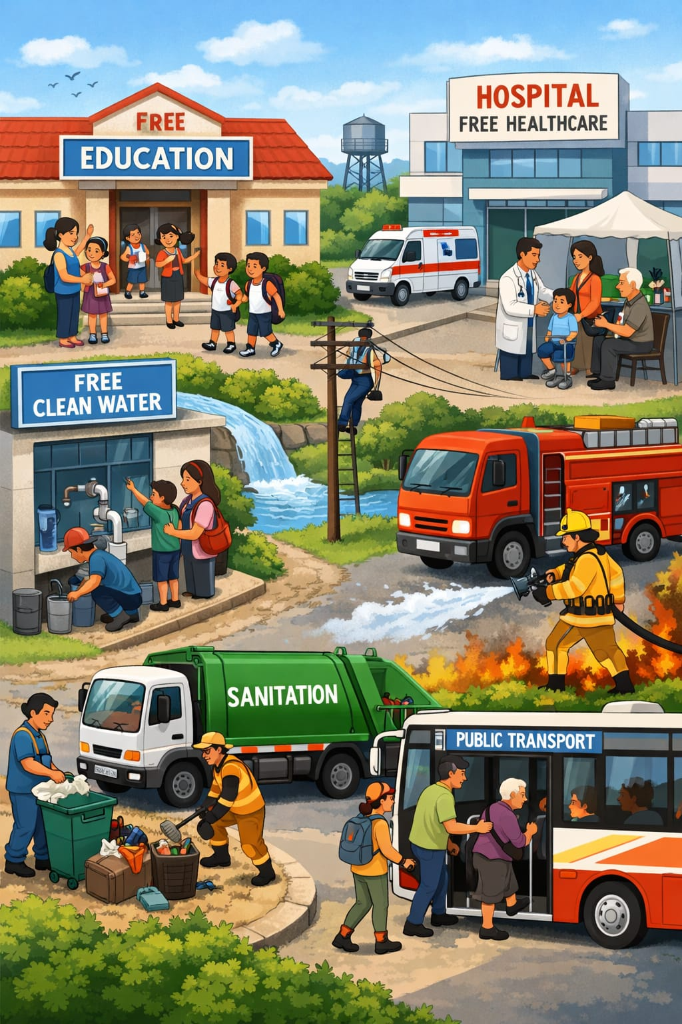
Meaning of Public Service Delivery
Institutional mechanism through which public services- Education, Health-care, water supply, sanitation, social security, etc.- are provided(delivered) to the people by local/ municipal, State, or central governments.
Public Services: Services which are either 'Public Good' or essential for people to fulfil their basic needs and are 'generally' provided by Governments
Public Goods: Goods/services which are non-excludable (no one can be denied), non-rivalrous(consumption by one does not reduce availability for other); Ex: public Roads, Parks, Clean air, street light, Traffic control, police service

Slide 2
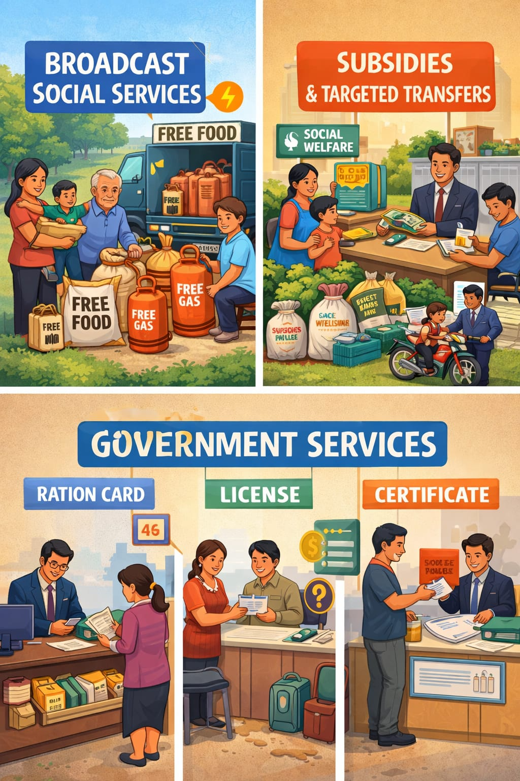
3 Types of Public Services:
Broad based social services: All public Goods, Public Education, Health-care, water and power supply, sanitation, social security, Employment exchanges, Employment
Subsidies and Targeted transfers: PDS (Ration shops), Input subsidies to Farmers, Free Electricity, free water, Gas cylinder, Direct Benefit transfers (DBTs)
All other kind of Govt services- Ration and other entitlement cards, Licenses, certificates, etc.

Slide 3
📌 Why are Public Services mainly provided by Government?
Public Goods Nature Some services (like street lights, clean air, national defense) are called public goods.
➡️ These are used by everyone, and you cannot stop anyone from using them.
➡️ So, private companies don’t earn profit easily → Government provides them.
Subsidies & Cash Support
➡️ Only the government can give subsidies, scholarships, pensions, and cash transfers.
➡️ Private sector cannot do this because their goal is profit.
Affordability for Poor People
➡️ Services like education, healthcare, transport may be provided by private sector,
❗ but poor people cannot afford high prices.
➡️ So, government provides them at low cost or free
Universal Access (Equal for All)
➡️ Government ensures everyone gets basic services like:
Water supply, Electricity
✅ In One Line:
👉 Government provides public services mainly to ensure fairness, affordability, and access for all, not just profit.

Slide 4
Challenges to Public Service Delivery
State Capacity
Government doesn’t always have enough money, staff, or systems.
So, it becomes difficult to provide good services (like health, education) to everyone.
Clientelism
Politicians give benefits only to selected groups or supporters.
➡️ Not everyone gets equal services.
➡️ It’s like “favoritism” in politics.
Information Gap
People don’t know how well government services are working.
Lack of awareness about quality and benefits of services.
Corruption
Money or resources get misused.
Services don’t reach the right people.
Example: leakage of funds, wrong targeting.
Public services fail mainly because of lack of resources, corruption, favoritism, and weak accountability.

Slide 5
