Slide 1
DIFFERENT TYPES OF BUDGET:
Annual and long-term budget:
ANNUAL BUDGET
👉 An annual budget is a financial plan prepared by the government for one financial year, showing estimated income and expenditure.
👉 An Annual Budget is a budget prepared for one financial year.
Explanation
👉 In most countries, the government prepares the budget every year.
👉 It includes estimated income and expenditure for one year.
🔹 Financial Year (Important for Exam)
In India and United Kingdom:
👉 1st April – 31st March
In United States, Australia, Sweden, and Italy:
👉 1st July – 30th June

Slide 2
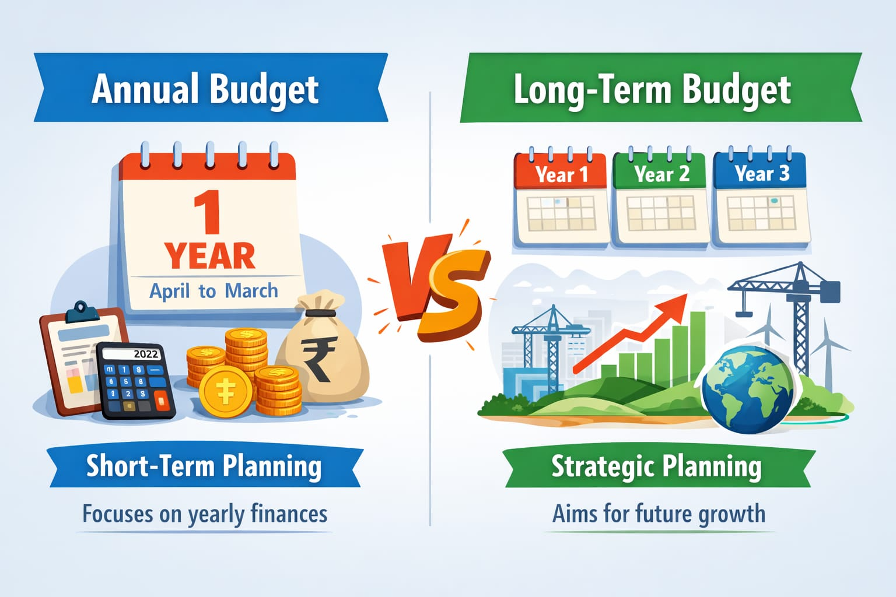
6
LONG TERM BUDGET
👉 A long-term budget is a financial plan prepared for more than one year, aimed at achieving long-term goals and development.
📌 Very Short
👉 Annual Budget: Budget for one year
👉 Long-Term Budget: Budget for many years (More than one year)

Slide 3
2. Single or plural budget:
Single budget:
👉 A single budget is a budget in which all government revenues and expenditures are included in one single document.
In this system, the government prepares only one budget.
It includes:
All income (revenue)
All expenditure
✔ Everything is shown together in one place.
Plural budget:
👉 A plural budget is a system in which the government prepares separate budgets for different departments or sectors.
Instead of one budget, multiple budgets are prepared.
Different departments have their own separate budgets.
🔹 Easy Example
👉 Government prepares:
Railway budget 🚆
Defense budget 🪖
General budget 📊
✔ Each is separate

Slide 4
3.Balanced, Surplus and deficit Budget
BALANCED BUDGET
🔹 Definition
👉 A balanced budget is a budget in which total revenue is equal to total expenditure.
🔹 Explanation
👉 Government income = Government spending
👉 There is no profit and no loss
🔹 Easy Example
👉 Income = ₹100 crore
👉 Expenditure = ₹100 crore
✔ Budget is balanced
SURPLUS BUDGET
🔹 Definition
👉 “A surplus budget is a budget in which total revenue is greater than total expenditure.”
🔹 Explanation
👉 Government earns more than it spends
👉 Extra money is called surplus

Slide 5
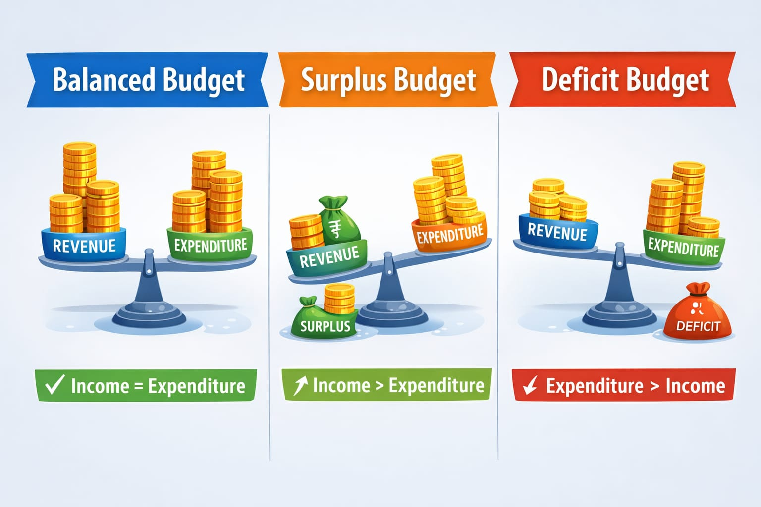
🔹 Easy Example
👉 Income = ₹120 crore
👉 Expenditure = ₹100 crore
✔ Surplus = ₹20 crore
DEFICIT BUDGET
🔹 Definition
👉 A deficit budget is a budget in which total expenditure exceeds total revenue.
🔹 Explanation
👉 Government spends more than it earns
👉 It may borrow money to cover the gap
🔹 Easy Example
👉 Income = ₹100 crore
👉 Expenditure = ₹130 crore
✔ Deficit = ₹30 crore
🔹 Simple Line
👉 Expenditure > Income

Slide 6
4.Cash or Revenue Budget
Definition
👉 Cash or Revenue Budget refers to a budget that deals with the actual cash receipts and payments or the regular income and expenditure of the government during a specific period.
🔹 Simple Explanation
👉 This type of budget focuses on day-to-day money matters
It includes:
Money coming in 💰 (fees, taxes, etc.)
Money going out 💸 (salary, bills, maintenance)
✔ It is about regular activities, not big investments
🔹 Very Easy Example
👉 A college has:
Income from student fees = ₹10 lakh
Expenses on:
Teachers’ salary
Electricity
Maintenance
✔ This is cash/revenue budget because it deals with daily expenses

Slide 7
////*
5.DEPARTMENTAL OR PERFORMANCE BUDGET
DEPARTMENTAL BUDGET
🔹 Definition
👉 A departmental budget is a budget in which separate budgets are prepared for each department of the government or organization.
🔹 Explanation
👉 Every department has its own budget
👉 Each department plans:
Its income
Its expenditure
✔ Helps in better control and management
🔹 Easy Example
👉 In a college:
Education department → teaching expenses
Sports department → sports budget
Library → books & maintenance
✔ Each has a separate budget
🔹 Simple Line
👉 Different departments = Different budgets

Slide 8
6
Performance Budget
🔹 Definition
👉 “A performance budget is a budget that shows not only expenditure but also the work done or results achieved.”
🔹 Explanation
👉 Focus is on:
Money spent 💰
Work done (performance) 📊
✔ It answers: What did we achieve with this money?
🔹 Easy Example
👉 Government spends ₹10 crore on education:
Number of schools built 🏫
Number of students benefited 👨‍🎓
✔ This is performance budgeting
🔹 Simple Line
👉 “Money + Work done = Performance budget”

