Slide 1
First Past the Post System
Prepared by Dr. Parismita Bhagawati
(as digital teaching material for Semester: 4th Semester
Course Name: POL040204: Political Processes in India; Unit I)

Slide 2
Meaning of Elections
Elections are the institutional process through which citizens choose representatives by voting.
These representatives act on behalf of the people in legislative bodies such as Parliament, state legislatures, or local governments.
Elections are inseparably linked to representative democracy, providing a structured mechanism for popular participation in governance.
Over the twentieth century, the principle of universal adult suffrage emerged, replacing restricted voting based on estate, property, race, gender, or education.
This expansion culminated in the democratic norm of “one person, one vote, one value”, ensuring formal political equality.

Slide 3
Historical Expansion of Suffrage
Early electoral systems restricted voting to landowners or privileged social groups.
Industrialisation, democratic movements, and social struggles gradually extended voting rights to individuals as citizens.
Previously excluded groups- women, racial minorities, and the working class—were enfranchised in most modern states.
Universal suffrage transformed elections from elite mechanisms into mass democratic institutions.

Slide 4
Functions of Elections
Formation of Government: Elections designate governments directly (presidential systems) or indirectly (parliamentary systems).
Political Accountability: Enable voters to reward or punish governments for their performance.
Public Legitimacy: Demonstrate popular support for, or rejection of, a regime.
Leadership Recruitment: Serve as a mechanism for selecting political leaders.
Communication and Feedback: Create a link between citizens and the state, transmitting public preferences.
In non-competitive or hegemonic party systems, these functions may be severely weakened, as outcomes are often predetermined.

Slide 5
Methods of Voting
Modern elections are conducted through the secret ballot, ensuring voter privacy.
The secret ballot protects voters from coercion, intimidation, and corruption.
Earlier systems, including public voting by show of hands, anow limited to small organizations.
Electoral fairness also depends on:
Access to balanced information
Freedom of campaigning
Transparency and integrity in vote counting

Slide 6
The Franchise: Who Can Vote?
Most contemporary democracies recognize universal adult citizenship as the basis of voting rights.
Formal exclusions based on gender, race, property, or education have largely disappeared.
Informal restrictions persist in some systems:
In the USA, voter registration is voluntary, contributing to low turnout.
Compulsory voting exists in countries such as Australia, Belgium, and Brazil, reinforcing participation.

Slide 7
Election Process: First Past the Post System
Meaning of the First Past the Post (FPTP) System
India follows the First Past the Post (FPTP) electoral system, inherited from the British Westminster model. Under this system, the country is divided into single-member territorial constituencies, and each constituency elects one representative to the legislature.
The defining principle of FPTP is that the candidate who secures the highest number of votes in a constituency is declared elected, irrespective of whether they obtain an absolute majority (50% + 1). Victory is therefore based on plurality, not majority.

Slide 8
How the FPTP System Operates in India
1. Division into Constituencies
India is divided into 543 Lok Sabha constituencies, each representing a specific geographical area.
Each constituency elects one Member of Parliament (MP).
Voters can vote only for candidates contesting from their own constituency.
2. Nomination of Candidates
Political parties may nominate one candidate per constituency.
Independent candidates are also permitted.
Indian elections often witness multi-cornered contests due to the presence of national, regional, and local parties.

Slide 9
3. Voting Process
Each voter casts one vote for one candidate.
Voting is conducted through Electronic Voting Machines (EVMs) by secret ballot.
There is no ranking or preference marking—only a single choice.
4. Counting of Votes
Votes are counted separately for each constituency.
All votes polled by each candidate are totalled.
5. Declaration of Results
The candidate who secures more votes than any other candidate in that constituency is declared elected.

Slide 10
Illustrative Constituency-Level Example
Assume a Lok Sabha constituency with 100000 valid votes:
Candidate | Party | Votes Polled
Candidate A | Party X | 35,000
Candidate B | Party Y | 33,000
Candidate C | Party Z | 20,000
Candidate D | Independent | 12,000
Candidate A wins with 35,000 votes.
However, 65% of voters voted against the winning candidate.
Despite this, Candidate A becomes the sole representative of the constituency.
This illustrates the winner-takes-all nature of FPTP.

Slide 11
Operation of FPTP at the National Level
Seat Majority as the Basis of Government Formation
Government formation in India depends entirely on the number of seats won in the Lok Sabha, not on the total percentage of votes secured nationwide.
The Lok Sabha consists of 543 elected members.
A party or coalition must secure at least 272 seats to form the government.
This majority is calculated only in terms of seats, not votes.
Thus, territorial victories aggregated nationally determine political power.

Slide 12
Why Vote Share Does Not Determine Government Formation
Votes are not pooled at the national level.
Each constituency is treated as a separate electoral contest.
Once a candidate wins a constituency, all other votes in that constituency play no further role in shaping national outcomes.
As a result, millions of votes may have no impact on government formation beyond the constituency in which they were cast.

Slide 13
How a Party Can Form Government Without Majority Vote Share
A party may win many constituencies by narrow margins and lose fewer constituencies by large margins, and still secure a majority of seats, even with less than 50% of the national vote share.
What matters is how votes are distributed across constituencies, not the total number of votes.

Slide 14
Simplified Illustrative National-Level Example (FPTP)
Assume a country has 5 constituencies, and each constituency elects one representative.
To form the government, a party must win at least 3 constituencies.
Election Results
Party A wins 3 constituencies, getting 4 out of 10 votes in each.
Party B wins 2 constituencies, getting 6 out of 10 votes in each.
Seat Count
Party A: 3 seats
Party B: 2 seats
➡ Party A forms the government because it has more seats.
Total Votes Across the Country
Party A total votes: 12
Party B total votes: 18
Even though Party B gets more votes overall, it does not form the government.

Slide 15
Critical Analysis
Advantages of the system
1. Simplicity of the FPTP system
FPTP is easy to understand and easy to use. You vote for one candidate, and the candidate with the highest votes wins.
Simple Indian example:
Think of a Lok Sabha election booth in a village.
You see symbols of candidates on the EVM.
You press one button next to the candidate you like.
Later, the candidate with more votes than others becomes the MP.
There is no ranking, no second preference, no calculation for the voter.

Slide 16
2. Strong candidate recognition and voter–representative relationship
Voters clearly know who their candidate is, and candidates know who their voters are.
Why this happens under FPTP:
Each constituency has one representative, so:
The candidate becomes a familiar face
Voters form a personal connection, not just a party-based one
This is much stronger than systems where representatives are chosen from long party lists and voters don’t know them personally.

Slide 17
3. Clear democratic responsibility and accountability
Citizens know exactly who is responsible for their constituency.
Because under FPTP:
One constituency = one representative
No confusion about responsibility
Why this is an advantage:
Representatives cannot shift blame
Voters know whom to praise or punish
In the next election, voters can clearly say:
“You did not work, so we will remove you.”
This strengthens democratic accountability.

Slide 18
4. Keeping extremism out of the legislature
Very small or extremist parties usually fail to win seats under FPTP unless they have strong local support.
Suppose a party has:
Very radical ideas
Only 1–2% support spread across the country
Under FPTP:
That party may get votes
But it will not win any constituency
So it does not enter Parliament easily

Slide 19
Why this is seen as an advantage:
Parliament remains relatively moderate
Law-making is not disrupted by fringe groups
Democratic institutions remain stable
This is particularly important in diverse societies like India, where social harmony matters.

Slide 20
Disadvantages of the FPTP system
1. Wasted Votes and Ignored Majority
In the First Past the Post (FPTP) system, only the votes of the winning candidate matter.
All votes cast for losing candidates are called “wasted votes” because they do not help elect anyone.
As a result, a large section of voters may remain unrepresented.
Example:
If four candidates receive 30, 35, 20 and 15 votes, the candidate with 35 votes wins. The remaining 65 votes are wasted, even though they represent the majority opinion.

Slide 21
2. Mismatch Between Votes and Seats
In FPTP, the number of seats won matters more than total votes received.
A party winning more votes nationwide may still get fewer seats in the legislature.
This happens because seats are counted constituency-wise, not vote-share-wise.
Result:
A party that comes second in votes can still form the government, raising questions about democratic fairness.

Slide 22
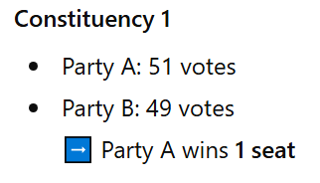
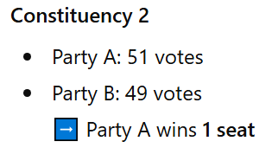
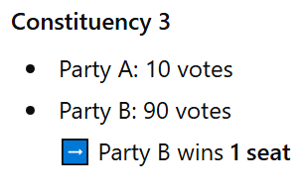
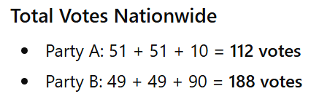
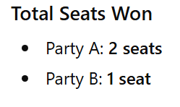
Mismatch Between Votes and Seats Example
Imagine a country with 3 constituencies and 2 parties:
Party A and Party B
Each constituency has 100 voters.

Slide 23
What Do We Observe?
Party B has far more votes nationwide (188 vs 112)
Yet Party A wins more seats and forms the government
Why This Happens in FPTP
Seats are awarded constituency by constituency
Winning by 1 vote or 50 votes makes no difference
Vote share across the country does not matter

Slide 24
3. Manufactured Majorities
FPTP often creates strong governments with weak public support.
Parties can secure a large majority of seats with only 30–40% of votes.
Such outcomes are called “manufactured majorities.”
Impact:
Governments may be legally valid but lack moral legitimacy, as most voters did not support them.

Slide 25
4. Lack of Majority Consent at Constituency Level
Winning candidates often secure victory with less than 50% of votes.
This means most voters in that constituency preferred someone else.
Yet, the elected representative speaks for the entire constituency.
Key Issue:
Representation without majority consent weakens democratic accountability.

Slide 26
5. Underrepresentation of Small Parties
In the First Past the Post (FPTP) system, only the candidate who secures the highest number of votes in a constituency wins the seat. Small and emerging parties usually receive votes spread across many constituencies, but they rarely finish first in any one seat.
Simple Demo Example
Imagine 4 constituencies with 3 parties:
Party A (large party)
Party B (large party)
Party C (small party)
Each constituency has 100 voters.

Slide 27
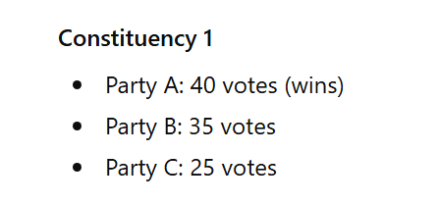
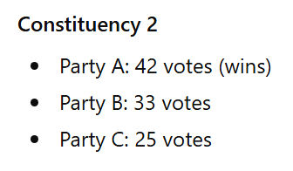
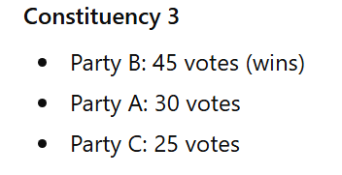
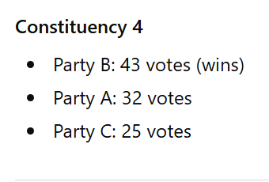

Slide 28
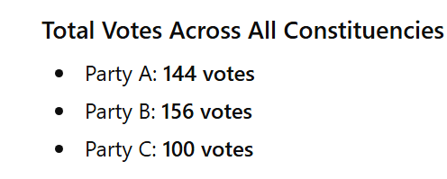
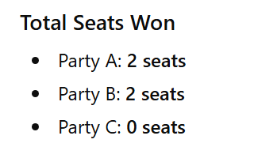
What Do We Notice?
Party C received 100 votes nationwide (25% of the vote in every constituency).
Despite consistent support, Party C wins zero seats.
All votes for Party C are treated as wasted votes under FPTP.

Slide 29
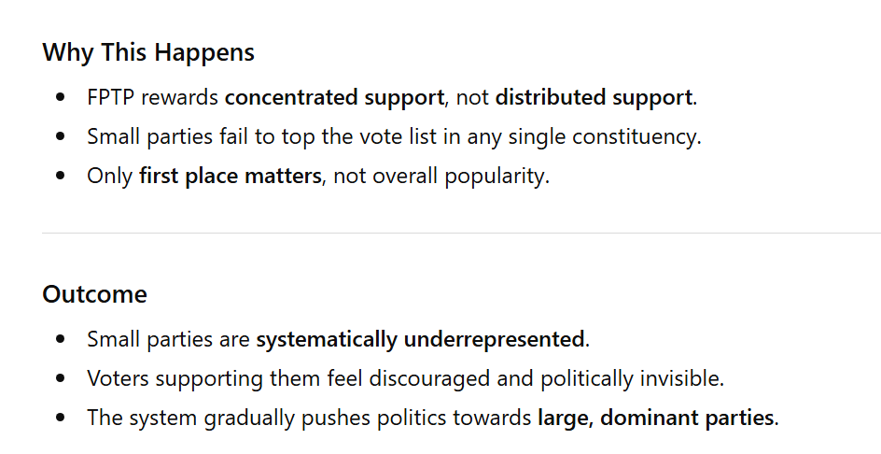

Slide 30
6. Underrepresentation of Social Minorities and Women
FPTP encourages parties to nominate “winnable” candidates only.
This often means candidates from dominant social groups, usually men with established vote banks.
Women and marginalised communities remain underrepresented.
Reason:
The problem lies in the structure of the system, not merely social attitudes.

Slide 31
7. Tactical (Strategic) Voting
Voters often vote not for their preferred candidate, but against the one they dislike most.
This happens when voters realise their favourite candidate has no chance of winning.
Effect:
Genuine voter choice is distorted
Democratic expression becomes defensive rather than free

Slide 32
8. Structural Barriers to Inclusive Politics
FPTP is a winner-takes-all system, making elections high-risk.
Parties become risk-averse and avoid nominating new or marginal voices.
Broad-based, inclusive platforms are discouraged.
Result:
Political innovation and social inclusion suffer.

Slide 33
The End

