Slide 1
Subject: Economics
Class: - FYUGP 1st Semester
Paper: Introductory Economics
Topic: Opportunity Cost
By
Dr. Binita Tamuli Barman
Associate Professor, Department of Economics

Slide 2
Opportunity cost
Opportunity cost is the value of the next best alternative that is forgone when a choice is made.
Because resources like time and money are limited, choosing one option means we must sacrifice another.
Thus, the real cost of any decision is not just the money spent, but also the benefit we could have received from the next best alternative.

Slide 3
Basic idea
Because resources are limited (time, money, land, labour), we cannot do everything. So every choice has a cost in terms of:-
The next best thing we could have done
The benefit we could have received from that next best option
That forgone benefit is called opportunity cost.

Slide 4
Simple examples
Student example - You have 2 hours
A: Study Economics
Option B: Watch a movie
If you choose to study, your opportunity cost is: The enjoyment/relaxation you would have got from watching the movie.
Money you have ₹1,000:Option
A: Buy a new pair of shoes
Option B: Attend a workshop that improves your skills
If you buy shoes, the opportunity cost is:
The knowledge and career benefits you could have gained from the workshop.

Slide 5
Why opportunity cost matters
It helps in better decision-making:
we compare what we gain vs. what we give up.
It reminds us that “cost” is more than just money – it includes time, comfort, future benefits.
It is central to economic choice, because scarcity forces us to choose, and every choice has a sacrifice.

Slide 6
Relationship Between Opportunity Cost and PPC
PPC is based on the concept of opportunity cost.
Because resources are scarce, producing more of one good requires sacrificing some quantity of another good.
Each point on the PPC shows a combination where resources are fully and efficiently used.
Moving from one point to another means reallocating resources.
The opportunity cost of producing an extra unit of a good is shown by the fall in output of the other good when we move along the PPC.
The concave shape of PPC reflects increasing opportunity cost, i.e. as more of one good is produced, more and more units of the other good must be sacrificed.

Slide 7
Let us suppose that the economy can produce two commodities, cotton and wheat. We suppose that the productive resources are being fully utilized and there is no change in technology. The following table gives the various production possibilities.

Slide 8
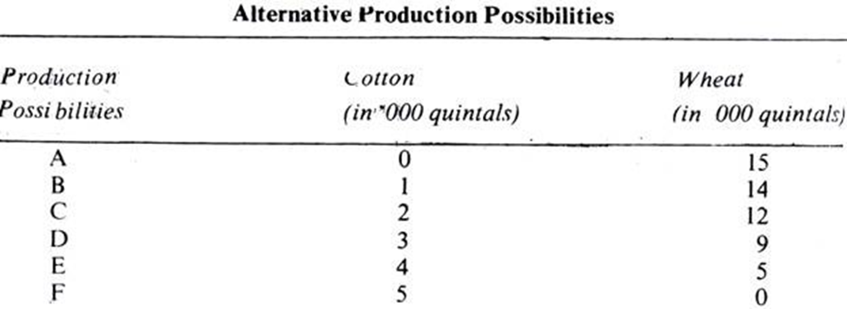
It all available resources are employed for the production of wheat, 15,000 quintals of it can be produced. If, on the other hand, all available resources are utilized for the production of cotton, 5000 quintals are produced. These are the two extremes represented by A and F and in between them are the situations represented by B, C, D and E. At B, the economy can produce 14,000 quintals of wheat and 1000 quintals of cotton.

Slide 9
At C the production possibilities are 12,000 quintals of wheat and 200u quintals of cotton, as we move from A to F, we give up some units of wheat for some units of cotton For instance, moving from A to B, we sacrifice 1000 quintals of wheat to produce 1000 quintals of cotton, and so on. As we move from A to F, we sacrifice increasing amounts of cotton.
This means that, in a full-employment economy, more and more of one good can be obtained only by reducing the production of another good. This is due to the basic fact that the economy’s resources are limited.

Slide 10
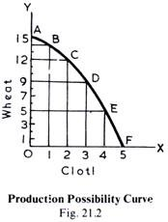
In this diagram AF is the production possibility curve, also called or the production possibility frontier, which shows the various combinations of the two goods which the economy can produce with a given amount of resources.
The production possibility curve is also called transformation curve, because when we move from one position to another, we are really transforming one good into another by shifting resources from one use to another.

Slide 11
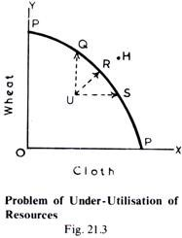
It is to be remembered that all the points representing the various reduction possibilities must lie on the production possibility curve AF and not inside or outside of it. For example, the combined output of the two goods can neither be at U nor H. This is so because at U the economy will be under-employing its resources and H is beyond the resources available.

Slide 12
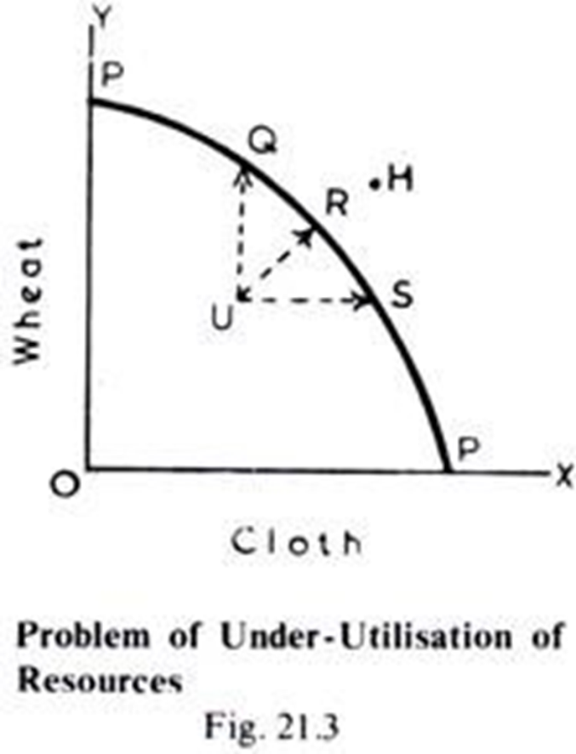
Meaning of Points on, Inside, and Outside the PPC
Points On the PPC (like R)Represent efficient use of resources.
The economy is using all resources fully and efficiently.
It shows maximum possible output combinations
Points Inside the PPC (like u)
Represent underutilization or inefficient use of resources.
Some resources are idle or wasted (e.g., unemployment, unused land, idle machines).
The economy can move from u to the PPC by better use of resources

Slide 13
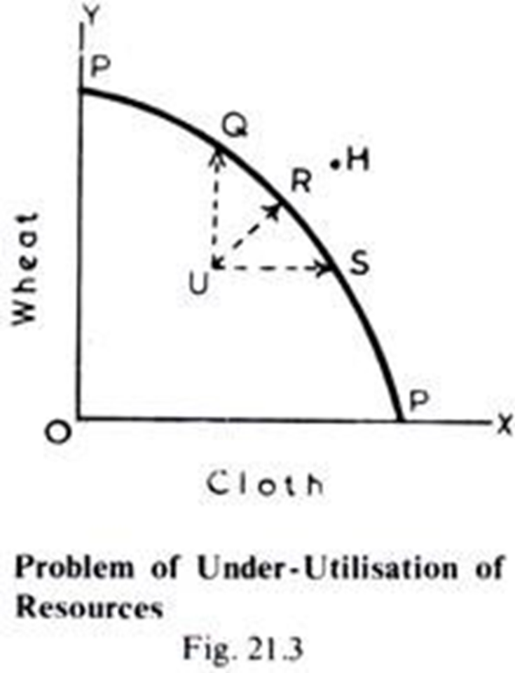
Points Outside the PPC (like H
Represent currently unattainable combinations with the existing resources and technology.
The economy cannot produce at H now. Such points may become attainable in the future.
if: resources increase, improves → PPC shifts outwards.

Slide 14
Cost of Production – What is it?
Cost of production means the total money spent by a firm to produce a good or service.
It includes things like:
Wages paid to workers
Rent paid for land or building
Interest on borrowed money
Price of raw materials Electricity, fuel, transport, etc.
Normal profit (in economics, profit is also treated as a cost needed to keep the producer in business)So,
Cost of production = all expenses incurred to produce and sell a product.

Slide 15
Types of Cost
Fixed Cost – does not change with output(e.g., rent of factory, salaries)
Variable Cost – changes with output(e.g., raw materials, wages of casual labour)
Total Cost = Fixed Cost + Variable Cost

Slide 16
Supply – What is it?
Supply refers to the quantity of a good that a producer is willing and able to sell at a given price in a given period of time.
Higher price ⇒ producer wants to supply more
Lower price ⇒ producer wants to supply less(other things remaining constant)

Slide 17
Relationship Between Cost of Production and Supply
If cost of production increases Example: raw materials become costly, wages rise.
Profit per unit falls
Producers are less willing to supply at the same price.
Supply decreases (supply curve shifts left)
If cost of production decreases Example: better technology, lower input prices
Profit per unit increases
Producers are more willing to supply at the same price.
Supply increases (supply curve shifts right)

Slide 18
Thank You

