Slide 1
Proportional Representation System
Prepared by Dr. Parismita Bhagawati
(as digital teaching material for Semester: 4th Semester
Course Name: POL040204: Political Processes in India; Unit I)

Slide 2
What is Proportional Representation?
Proportional Representation (PR) is an electoral system.
It was developed in the 19th century.
It was adopted by many European democracies in the early 20th century.
Countries like the UK and France mostly did not adopt it.
Today, PR is widely used for national parliamentary elections in many countries.

Slide 3
Basic Principle of PR
The main idea of PR is fairness between votes and seats.
A party’s share of seats in the legislature should match its share of votes.
👉 In simple words:
If a party gets X% of votes, it should get about X% of seats.

Slide 4
Why PR was Introduced
To reduce unfairness seen in majority systems like FPTP.
To avoid situations where:
A party gets many votes but very few seats.
To ensure better representation of all political opinions.

Slide 5
Key Objective of PR
To create a close link between votes cast and seats won.
To give smaller parties a fair chance of representation.
To make the legislature more reflective of voter preferences.
“Proportional Representation is a system where parties get seats in proportion to the votes they receive, aiming for fairness and better representation of voter preferences.”

Slide 6
Characteristics
1. Larger district magnitude
District magnitude = how many representatives are elected from one area
In FPTP
Guwahati city is divided into separate Assembly constituencies such as
Dispur, Jalukbari, Panbazar–Uzanbazar, etc.
Each constituency elects only ONE MLA
Suppose Guwahati has 6 Assembly constituencies
Total representatives elected from Guwahati = 6 MLAs
So under FPTP:
One constituency → one representative

Slide 7
In PR:
Guwahati is treated as ONE big constituency
Instead of dividing it into many small constituencies
From this one Guwahati constituency, 6 representatives are elected together
So under PR:
One constituency → many representatives
👉 This is what “larger district magnitude” means
The size of representation from one area increases.

Slide 8
2. Multimember constituency
A multimember constituency simply means:
One constituency elects more than one person
In our example:
Guwahati = one constituency
Number of representatives elected = 6
So Guwahati becomes a multimember constituency.
👉 Very simple definition
If more than one representative is elected from the same area, it is called a multimember constituency.

Slide 9
3. How votes translate into seats
Now let us imagine an election in Guwahati city.
Three parties contest:
Party A → 3,00,000 votes
Party B → 1,80,000 votes
Party C → 1,20,000 votes
Total votes in Guwahati = 6,00,000
Guwahati has 6 seats under PR.

Slide 10
Under PR:
Party A gets 50% votes → 3 seats
Party B gets 30% votes → 2 seats
Party C gets 20% votes → 1 seat
👉 Key idea
Votes and seats move together.
Even if a party does not come first, its votes still convert into seats.
So, no vote is wasted.

Slide 11
4. Single national constituency — what does this mean?
Now imagine something even bigger.
Instead of Guwahati or Assam:
The entire country of India is treated as ONE constituency
Example:
Total seats in Parliament = 100 (imaginary number for understanding)
Party A gets 40% votes across India → 40 seats
Party B gets 35% votes → 35 seats
Party C gets 25% votes → 25 seats
👉 This is what “single national constituency” means
There are no local constituency divisions — all votes are counted together at the national level.

Slide 12
5. Single vote
“If Guwahati elects 6 representatives, do voters get 6 votes?”
Answer: NO.
In PR:
Each voter gives only ONE vote
That one vote helps decide:
How many seats each party gets
In our example:
One voter votes for Party B
That vote is added to Party B’s total votes in Guwahati
Party B’s total votes decide whether it gets 1 seat, 2 seats, or more

Slide 13
Types of Proportional Representation
Single Transferable Vote (STV)
List System

Slide 14
Single Transferable Vote (STV)

Slide 15
STV is a PR method where voters rank candidates (1, 2, 3…), and seats are filled by reaching a minimum vote target called a quota; extra and eliminated votes are transferred according to next preferences until all seats are filled.

Slide 16
Multimember constituencies
Unlike FPTP (1 seat per constituency), STV works where one constituency elects multiple members.
Example: A constituency elects 4 members (M = 4).
Preferential voting with a single vote
You are not “giving many votes.”
You have one vote, but you rank candidates.
Your vote can “move” if your earlier preference becomes unnecessary (surplus) or impossible (candidate eliminated).

Slide 17
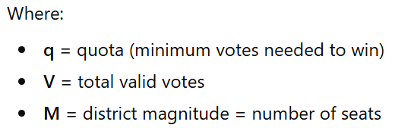
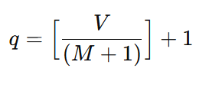
The Key Mathematical Idea: Droop quota
Why a quota?
If there are multiple seats, we need a rule to decide:
“How many votes are enough to guarantee election?”
That minimum is the quota.
Droop quota formula

Slide 18
Count 1st pref → Elect ≥ quota → Transfer surplus → Eliminate last → Transfer → Repeat

Slide 19
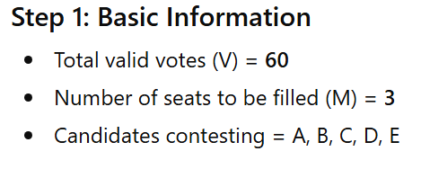
Clear Worked Example

Slide 20
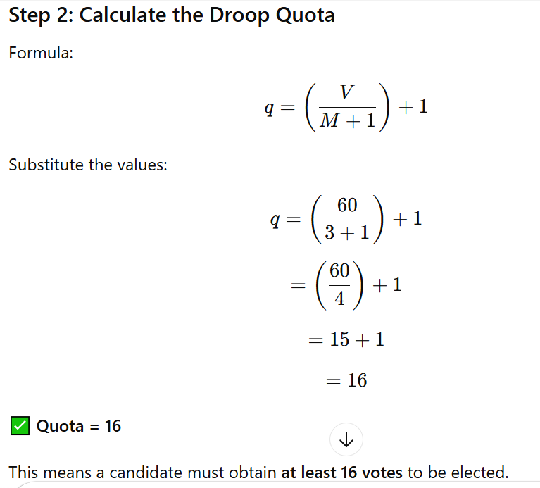

Slide 21
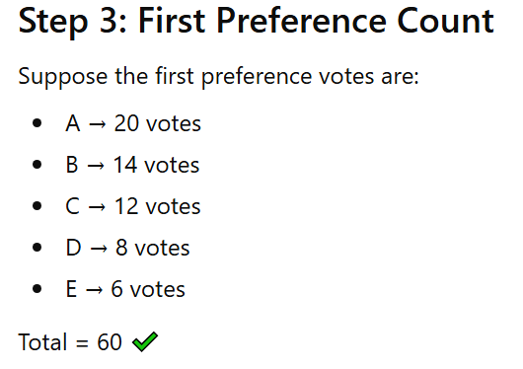

Slide 22
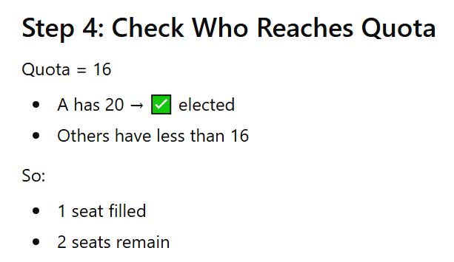

Slide 23
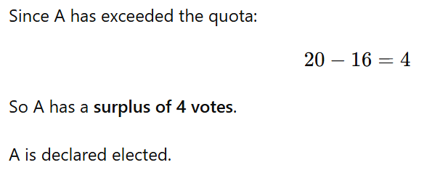
Transfer of Surplus Votes

Slide 24
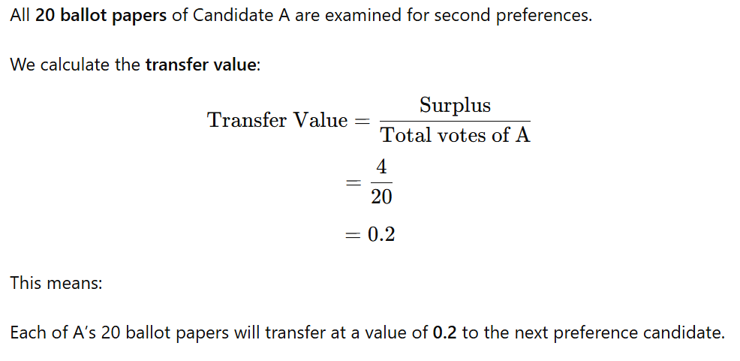

Slide 25
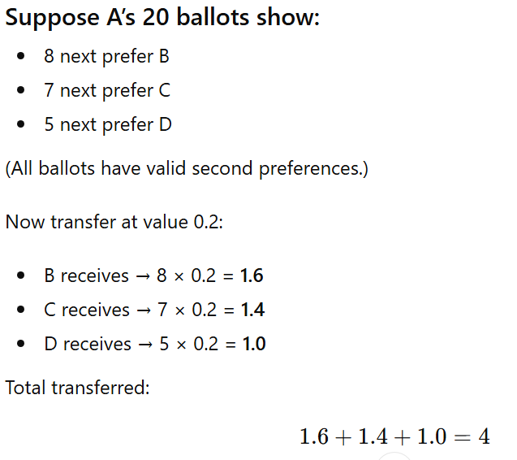

Slide 26
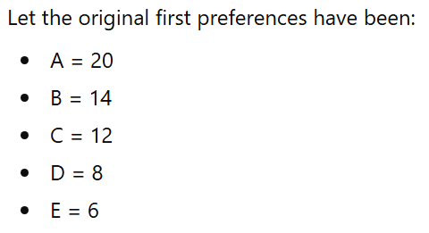
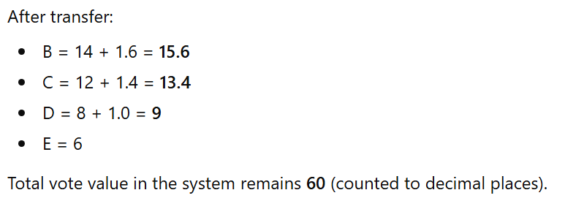
Updated Totals After Surplus Transfer

Slide 27
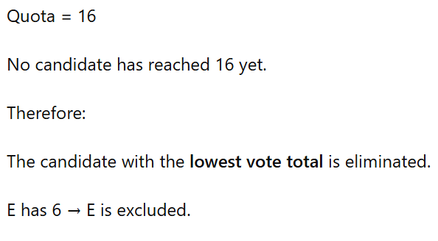
Step 5: Check for Quota again

Slide 28
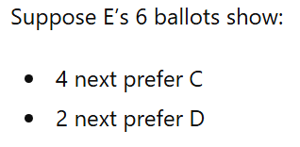
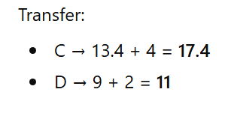
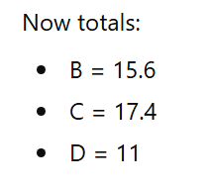
Transfer of Eliminated Candidate’s Votes
E’s votes transfer at their current value.
Since E’s votes were first preference votes, they each count as 1.00000.

Slide 29
C has now exceeded quota.
C is declared elected.
Seats filled: A and C
One seat remains.

Slide 30
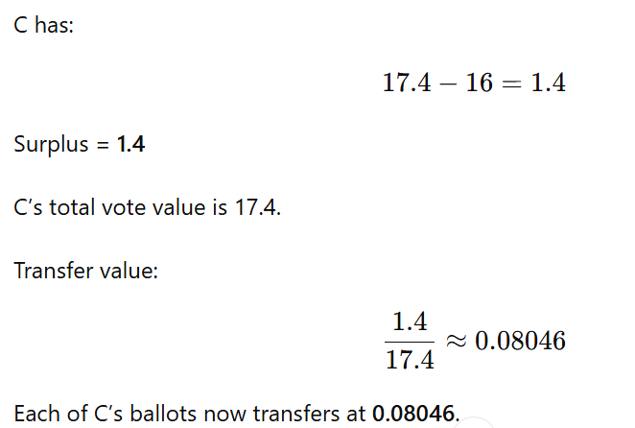
Transfer of C’s Surplus

Slide 31
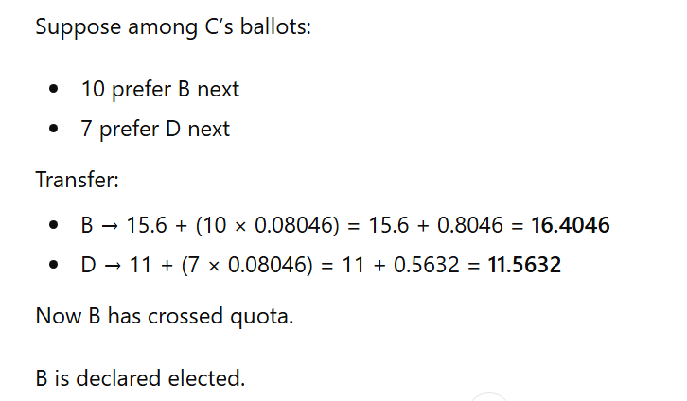

Slide 32
Step 6: Election Complete
Seats filled:
✔ A
✔ C
✔ B
Total seats = 3.
This process continues until:
Another candidate reaches the quota, OR
The number of remaining candidates equals the number of remaining seats.
In the final stage, a candidate may be elected with slightly more or slightly less than quota depending on the situation.

Slide 33
Alternative Scenario
What if C gets exactly the quota (16)?

Slide 34
Some Facts on the Droop Quota
It’s named after Henry Richmond Droop (1831–1884), an English mathematician and lawyer who specialized in election systems.
While a man named Thomas Hare originally came up with a simpler quota, Droop realized that Hare’s version was actually too high and made it harder to fill all the seats. Droop refined the math in 1868 to create the most efficient "magic number" possible.

Slide 35
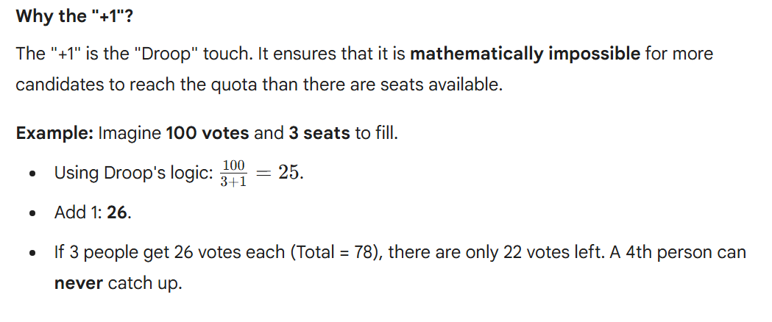

Slide 36
Use of the STV in Rajya Sabha Elections

Slide 37
Hypothetical Scenario: A Rajya Sabha Seat from Assam Becomes Vacant
Suppose:
One Rajya Sabha member representing Assam completes their 6-year term.
That seat now has to be filled.

Slide 38
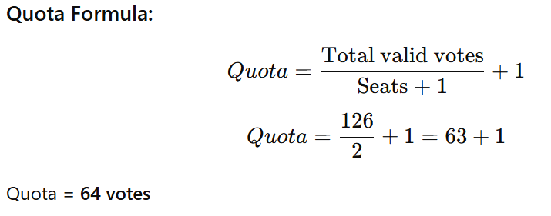
Step 1: Identify the Voters
Assam Assembly has 126 MLAs.
These 126 MLAs form the electoral college.
Step 2: Suppose 1 Seat is to Be Filled
If only 1 seat is vacant:

Slide 39
Ballot Structure (How MLAs Vote)
MLAs do not vote separately for each seat.
Instead, they rank candidates in order of preference:
1 → First preference
2 → Second preference
3 → Third preference
Giving second or later preferences is optional.
This is called an ordinal ballot system.

Slide 40
Open Ballot System in Rajya Sabha Elections
Meaning
In Rajya Sabha elections, voting by MLAs is not completely secret. It follows an open ballot system, where party MLAs must disclose their vote to their party’s authorized agent.
How It Works
MLAs rank candidates in order of preference under the Single Transferable Vote (STV) system.
A party MLA must show the marked ballot paper to the authorized agent of their own political party.
The agent can only verify the vote; they cannot direct or influence voting at that moment.

Slide 41
Rules
If a party MLA refuses to show the ballot to their party agent, the vote becomes invalid.
An independent MLA must not show their ballot to anyone; doing so makes the vote invalid.
A party MLA cannot show the ballot to an agent of another political party; this also invalidates the vote.

Slide 42
Why Was Open Ballot Introduced?
It was introduced in 2003 to stop cross-voting and bribery.
Earlier, Rajya Sabha voting was secret.
This led to:
MLAs secretly voting against their own party
Horse-trading
Bribery
Corruption in indirect elections
So Parliament amended the law to make it “open”.

Slide 43
Conceptual Logic
Rajya Sabha election is:
Not an election of conscience
Not a general public mandate
It reflects party strength in Assembly
So the law prioritizes:
Party discipline
Stability
Anti-corruption safeguards
Over secrecy.

Slide 44
Where else is STV used internationally?
Senate of Australia.
Parliamentary elections in Ireland
Parliamentary elections in Malta

Slide 45
List System

Slide 46
1. What is the List System?
The List System is a form of Proportional Representation (PR).
In this system:
People vote for political parties, not individual candidates.
Each party prepares a list of candidates in advance.
Seats in the legislature are distributed according to the percentage of votes each party receives.
It is considered the purest form of proportional representation because seat share closely matches vote share.

Slide 47
2. How Constituencies Work in List System
There are two main arrangements:
(A) Whole Country as One Constituency
The entire country is treated as a single electoral unit.
Example countries:
Netherlands
Israel
Slovakia
In this case:
All votes are counted nationally.
Seats are allocated based on total national vote share.

Slide 48
(B) Multi-Member Constituencies
The country is divided into regions, and each region elects multiple representatives using party lists.

Slide 49
3. What Do Parties Do?
Before the election:
Each party prepares a ranked list of candidates.
The list may contain:
Exactly as many names as total seats
The order matters.

Slide 50
Example:
Party A List:
Candidate X
Candidate Y
Candidate Z
Candidate W
If Party A wins 3 seats → Only X, Y, Z enter the legislature.

Slide 51
4. What Do Voters Actually Vote For?
Voters:
Do not vote for individual persons.
They vote for a party symbol or party name.
So the vote means:
“I support this party’s list.”

Slide 52
5. How Seats Are Allocated
Seats are distributed in proportion to votes received.

Slide 53
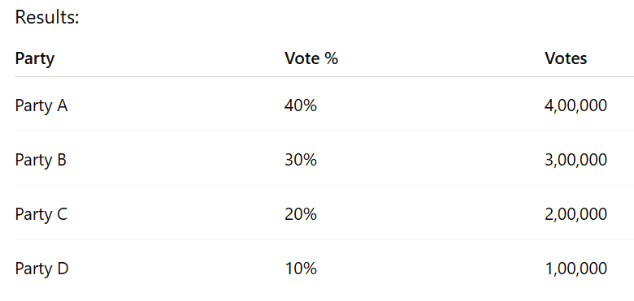
Example 1: National List System
Suppose:
Legislature has 100 seats.
Total votes cast = 10,00,000.

Slide 54
Seat allocation:
Party A → 40 seats
Party B → 30 seats
Party C → 20 seats
Party D → 10 seats
Each party then fills seats from its list in order.

Slide 55
6. Why Is It Called “Pure” Proportional Representation?
Because:
Vote share ≈ Seat share
Very little distortion
Small parties get representation
Minority opinions are included

Slide 56
Closed List System
Countries like Israel, South Africa and Spain use this system.
How It Works
Each party prepares a ranked list of candidates.
The order is fixed by the party.
Voters vote only for the party, not for individual candidates.
Voters cannot change the order of candidates.

Slide 57
Example
Suppose Party A’s list looks like this:
A
B
C
D
E
Now suppose Party A wins 3 seats.
Who gets elected?
→ A, B, and C (the top three on the list).
Voters have no control over this order.

Slide 58
Key Idea
The party decides:
Who is placed at the top.
Who gets priority.
Who actually enters the legislature.
So, control lies mainly with party leadership.

Slide 59
Open List System
Countries like Finland, Chile, Denmark and Netherlands use this model (with variations).
In an open list proportional representation system:
Parties present a list of candidates.
Voters choose: A party, and An individual candidate within that party.
The number of seats a party wins depends on its total votes.
Which individuals fill those seats depends on how many personal votes they receive.
So there are two layers:
Party vote determines how many seats the party gets.
Candidate vote determines who from the party gets those seats.

Slide 60
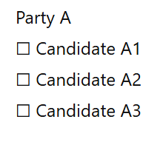
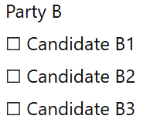
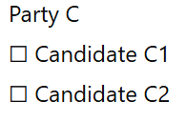
Common Ballot Structure
The ballot is divided by party columns.
The voter:
Selects one candidate from one party list.
That vote counts as:
A vote for the party.
A personal vote for that candidate.

Slide 61
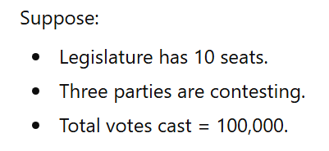
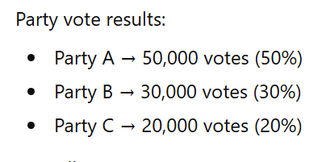
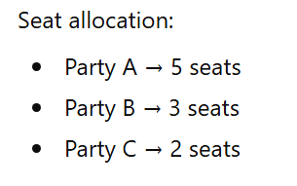

Slide 62
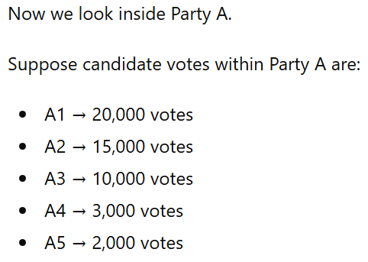
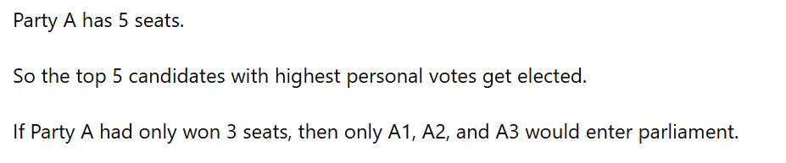

Slide 63
Advantages

Slide 64
Minimizes Wasted Votes
Seats are allocated roughly in proportion to vote share.
Very few votes are ignored compared to FPTP.
Encourages Representation of Small Parties
Even smaller parties can win seats if they cross the minimum threshold.
Votes are counted for seat allocation, not simply discarded.

Slide 65
Better Inclusion of Women and Minorities
Party list systems allow deliberate inclusion of diverse candidates.
Ensures broader social representation in legislatures.
Promotes Higher Political Participation
Fewer wasted votes motivate voters to participate.
Citizens feel their vote directly influences representation.
Creates a More Representative Legislature
Reflects diversity of interests, opinions, and social groups.
Produces legislatures closer to actual voter preferences.

Slide 66
Disadvantages

Slide 67
Weak Representative–Constituency Link
Large district magnitude reduces direct contact between voters and representatives.
Voters vote for parties, not individual candidates (especially in list PR).
Accountability to local constituencies becomes unclear.

Slide 68
Party Control Over Candidate Selection
Candidates are selected through party-prepared lists.
In closed-list systems, party leadership determines ranking.
Reduces voter influence over individual representatives.

Slide 69
Reduced Local Responsiveness
Representatives may prioritize party leadership over local issues.
Limited sensitivity to constituency-specific concerns.
Difficulty in Removing Unpopular Representatives
If a party places the same candidate high on the list again,
the candidate may be re-elected based on party vote share.
Voters have little direct mechanism to reject specific individuals.

Slide 70
Leads to Fragmented Legislatures
Representation of many parties results in a divided legislature.
No single party often secures an absolute majority.
Frequent Coalition Governments
Governments are formed through alliances of multiple parties.
Single-party majority governments become less common.
Potential Governmental Instability
Coalition governments may collapse due to internal disagreements.
Policy-making can be slow due to bargaining and compromise.

Slide 71
Difficulty in Government Formation
In highly fragmented legislatures, forming a coalition may be complex.
Negotiations can delay governance.
Criticism of Ineffective Policy-Making
Instability may weaken long-term planning.
Frequent changes in alliances can disrupt governance continuity.

