Slide 1
Understanding Power and its Different Dimensions
Prepared by Dr. Parismita Bhagawati
(as digital teaching material for Semester: 2nd Semester (PG)
Course No. POL2016
Political Theory -I ; Unit III)

Slide 2
Concept of Power in Social Sciences
The most general understanding of power refers to the ability to achieve a desired outcome — often termed power to.
Power to denotes a capacity possessed by an actor to accomplish specific goals.
It is:
Instrumental in nature (a means to an end)
Held by an actor (usually consciously)
Deployed toward achieving intended outcomes
Example: The ability to purchase goods, make decisions, or influence events.

Slide 3
Power as Relationship: Power Over
The dominant contemporary understanding views power as a relationship.
Power over refers to the exercise of control by one individual or group over another.
Key features:
Power is not studied primarily through the actor alone.
It is identified within relations between actors.
It implies a structure of domination.

Slide 4
Reconciliation of the Two Views
The two perspectives can be integrated by defining power as:
→ A capacity to dominate within social relations.
In this sense, power includes:
The ability to make formal decisions
Decisions that are binding on others
Authority exercised across different social spheres

Slide 5
Examples of Institutionalised Power
Teachers exercising authority in classrooms
Parents exercising authority within families
Government ministers making binding decisions for society

Slide 6
Power to → ability
Power over → control
Reconciliation → ability to exercise control
So power can be defined as:
A socially recognised capacity that allows an actor to make decisions that are binding on others.

Slide 7
Power as an Essentially Contested Concept
Power is regarded as an essentially contested concept
→ No single, settled definition is universally accepted.
→ Different definitions serve different theoretical purposes.
Associated with Steven Lukes in Power: A Radical View ([1975] 2004).

Slide 8
Different dimensions: Power as decision making

Slide 9
The first face of power is associated with Thomas Hobbes.
Power is defined as the ability of an agent to affect the behaviour of a patient.
This conception is analogous to physical or mechanical power:
Power operates as a force.
It involves being ‘pulled’ or ‘pushed’ against one’s will.

Slide 10
Power is therefore understood as:
Direct influence
Observable behaviour change
Conflict between actors
This view became central to mainstream twentieth-century Anglo-American political science.
It was closely associated with the dominance of behaviourism during the 1950s and 1960s.

Slide 11
Robert A. Dahl defined power as the ability to influence the decision-making process.
For Dahl, power is fundamentally about who gets their way, how often, and over what issues.
His classic formulation states:
“A has power over B when A can get B to do something that B would not otherwise do.” (1957)
This represents a one-dimensional view of power, where power is visible in overt conflict and decision-making and operates as a relation of domination when one actor compels another to act against their stated preferences.

Slide 12
There are four theoretical assumptions in this model.
First, power is treated as an attribute of individuals and is identifiable in their behaviour toward others. If A influences B in interaction, we observe power through what A and B actually do.
Second, power is understood as power over, meaning domination. It is not merely the capacity to achieve an outcome (power to), but the ability of A to dominate B in order to produce that outcome.
Third, power exists only when it produces an effect. If A attempts to dominate B but fails, then power is not present. Power is visible only when B’s behaviour actually changes.
Fourth, power is zero-sum. In any interaction between A and B, if A gets B to do something B would not otherwise do, then A has power and B does not in that situation.

Slide 13
This view has several theoretical advantages. First, it matches the common-sense idea that power is about success, meaning achieving outcomes. It also reflects the everyday understanding that power concerns decisions and how they are made.
For political theorists and scientists, this definition has strong methodological advantages. It is clear and parsimonious, meaning it is simple, precise, and not unnecessarily complex.
It can be operationalized in an empirical study of the distribution of power within a group, community, or society.
The method involves three main steps:
Selecting key decision-making areas.
Identifying the actors involved and discovering their preferences.
Analysing the decisions made and comparing them with the preferences of the actors.
If an actor’s preferences match the final decision, that actor is considered to have exercised power.

Slide 14
Why was this considered a theoretical advantage?
Because earlier discussions of power were:
Abstract
Philosophical
Difficult to measure
Normative rather than empirical
Dahl’s model made power researchable.

Slide 15
This definition of power was enthusiastically adopted by political scientists and sociologists, particularly in the United States, during the late 1950s and 1960s.
It aligned with the dominant behaviourist approach and its emphasis on empirical, measurable research.
It led to the development of numerous community power studies, which examined how power was distributed within specific cities or local communities.
These studies investigated who influenced key decision-making areas, whose preferences prevailed, and whether power was concentrated or dispersed.
The most famous such study was Dahl’s own analysis of the distribution of power in Who Governs? ([1963] 2005)

Slide 16
Limitations of this View of Power
Although simple and clear, this conception of power has limitations because it focuses only on observable decisions. It ignores situations where A prevents an issue from even being discussed. For example, if A ensures that workers’ wage demands never reach the meeting agenda, no decision is made — but power is still being exercised. This criticism leads to the idea of the second face of power.

Slide 17
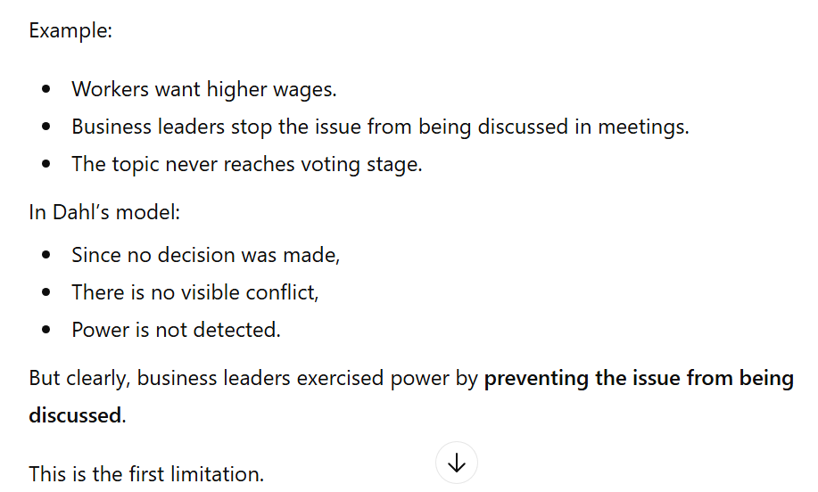
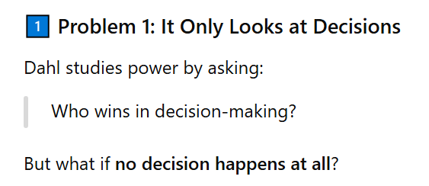

Slide 18
This model is also actor-centred, meaning power exists only in direct relationships between identifiable individuals like A and B. It does not recognise that power can operate through larger cultural, social, or historical structures.

Slide 19
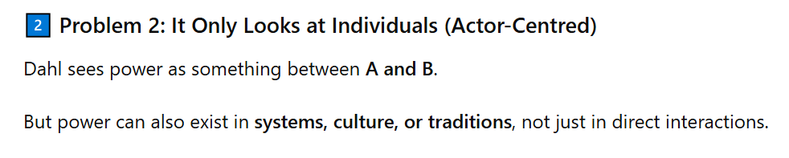
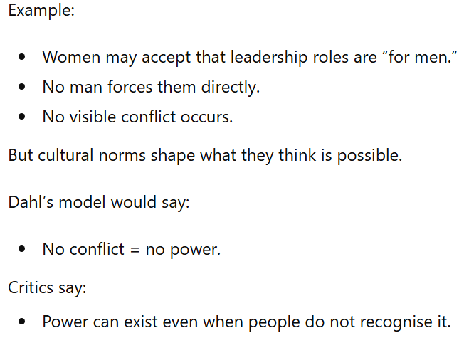

Slide 20
Because it is strongly agency-centred, power is seen only when there is observable conflict between A and B. If B does not openly resist or express dissatisfaction, then power is assumed not to exist. For example, if B quietly accepts unequal treatment without questioning it, this model would not recognise that B is under power.
The model assumes that an actor’s interests are the same as their stated preferences. It does not distinguish between what B openly says they want and what may actually be in B’s deeper or real interest. For example, if B says they are satisfied with low wages because “that is how things are,” this approach treats that statement as fully reflecting B’s true interest.

Slide 21
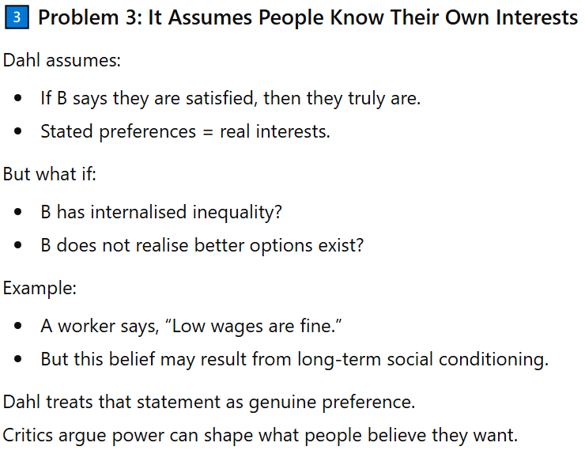

Slide 22
Dahl’s model misses:
Power that stops issues from being discussed.
Power that operates through culture and systems.
Power that shapes people’s beliefs and preferences.
That is why later theorists proposed the second and third faces of power.

Slide 23
Agenda-Setting – The Second Face of Power

Slide 24
The second face of power is a revision of the first; it expands the meaning of power beyond visible decision-making.
It responds to the criticism that focusing only on observable decisions gives too narrow a view of power’s outcomes.
In The Two Faces of Power, Peter Bachrach and Morton S. Baratz introduced the idea of “non-decision-making” as the second face of power.
They argued that power is not only about influencing decisions, but also about controlling which issues are allowed to reach the decision-making stage.

Slide 25
If A creates or reinforces barriers that prevent certain policy conflicts from being publicly discussed, A is exercising power.
For example, if A ensures that wage reform is never placed on the agenda, B never even gets the chance to demand it — this is power through agenda-setting.
Thus, power operates not only in visible conflicts, but also in shaping what is considered legitimate for discussion.

Slide 26
Neo-Elitist Reformulation
Revising Dahl’s formula, Peter Bachrach and Morton S. Baratz argue that power exists when:
“A devotes his energies to creating or reinforcing social and political values and institutional practices that limit the scope of the political process to public considerations of only those issues which are comparatively innocuous to A.”
This form of power is called non-decision-making — it refers to decisions that exclude certain issues from discussion because they threaten A’s interests.
Power here lies in controlling what is allowed onto the political agenda, not just in winning visible decisions.

Slide 27
E. E. Schattschneider expressed this clearly:
“Some issues are organized into politics while others are organized out.”
Power, therefore, is the ability to set the political agenda for the decision-making process.
For example, if business elites ensure that environmental regulations are never debated in parliament, the issue is “organized out,” and power is exercised even though no vote occurs.
Identifying this form of power is more complex than studying decision-making because it requires analysing the dynamics of exclusion and silence.
Schattschneider summarized this insight in the phrase:
“Organization is the mobilization of bias,”
meaning political structures are arranged in ways that systematically favour some interests while blocking others.

Slide 28
The second face of power introduces two important innovations. First, it expands the idea of political power beyond formal decisions to include informal agenda-setting — the process through which certain issues are allowed or prevented from reaching decision-making.
This makes the theory more institutionally sophisticated, because it recognises that power operates not only in voting or legislation, but also in controlling discussion and debate.
Second, it allows us to examine and weigh different forces — both formal (votes, laws) and informal (party strategies, media silence) — to determine where power actually lies.

Slide 29
Such a face of power is exercised when major parties either:
Implicitly ignore an issue because raising it may cost them electoral support, or
Fundamentally agree not to challenge a sensitive topic.
For example, climate change has often struggled to become a central political issue because decision-makers may perceive economic or political costs in addressing it seriously.
In such cases, the issue is not openly rejected — it is simply kept off the mainstream agenda.

Slide 30
Third Face of Power – Preference Manipulation or Thought Control

Slide 31
Steven Lukes identifies the third and most significant face of power as manipulating desires or thought control.
Power here is not overt domination, but the ability of A to influence, shape, or determine B’s very wants.
Power operates by shaping perceptions, cognitions, and preferences, so that B accepts the existing order without resistance.
Lukes argues this is the most insidious form of power because people may not even realise that power is being exercised over them.

Slide 32
He asks whether the deepest exercise of power is preventing people from having grievances by shaping their understanding so that they:
See no alternative to the system,
Regard it as natural or unchangeable,
Or believe it to be divinely ordained or beneficial.

Slide 33
This is a radical view of power, because it does not define power solely through observable behaviour between A and B.
It opens the possibility of structural power, where historical, cultural, and social systems shape beliefs and consciousness.
This view requires distinguishing between perceived (felt) interests and real (objective) interests.
It is controversial because it assumes that people may accept arrangements that are not truly in their objective interest due to ideological influence.

Slide 34
Third Face of Power and Marxism
Lukes’s third dimension of power is not entirely new; it reflects a long-standing tradition in political thought, especially within Marxism.
The power of the bourgeoisie is not only economic and political but also ideological.
According to Karl Marx, the dominant ideas in any society are the ideas of its ruling class.
In The German Ideology, Marx and Engels state:
“The class which has the means of material production at its disposal, has control at the same time over the means of mental production…”

Slide 35
This means that the class controlling economic resources also controls education, media, religion, and cultural institutions — shaping how people think.
Marx further argues that:
“The ruling ideas are nothing more than the ideal expression of the dominant material relationships…”
In simple terms, the dominant class presents its interests as universal and natural, even though they support existing inequalities.
The working class, or proletariat, comes to understand society through these dominant ideas.
Engels described this condition as “false consciousness” — a situation where exploited groups fail to recognise their own exploitation.

Slide 36
Thus, the real (objective) interests of the proletariat — abolishing capitalism — differ from their felt (perceived) interests, which may support or accept the existing system.
This aligns with Lukes’s third face of power: power operates by shaping beliefs so that people accept arrangements that work against their own objective interests.

Slide 37
In The Second Sex, Simone de Beauvoir examines women’s complicity in patriarchy through the concept of “Bad Faith.”
De Beauvoir argues that domination persists partly because women may internalise and accept subordinate roles, sometimes deriving security or satisfaction from them.
This reflects Lukes’s third face of power: domination operates by shaping consciousness so that oppressed groups do not fully recognise or resist their subordination.
Feminist structural analysis thus distinguishes between felt interests (accepting dependency) and real interests (emancipation and equality).

Slide 38
Postcolonial Theory and Structural Power
Postcolonial theorists argue that colonialism is a structure of domination, not just a past historical event.
Its effects are not only material and economic, but also cultural and psychological.
In Orientalism, Edward Said argues that colonialism shaped knowledge itself.
The West constructed the idea of the “Orient” as inferior, irrational, and backward, creating a relationship of power and hegemony between Occident and Orient.
The Orient was not simply discovered; it was actively “Orientalized” — shaped and represented in ways that justified domination.

Slide 39
These colonial images were later internalised by colonised societies, affecting their self-understanding and cultural values.
Therefore, colonial power continues through representation, discourse, and ideology, even after political independence.
This raises the question: if domination continues culturally and psychologically, how “post” is colonialism?

Slide 40
Limitations of the Third Face of Power
If we say people’s felt interests are false and their real interests are different, we must explain:
→ Who decides what is “real”?
If people say they are satisfied, and we claim they are deluded, we need a standard of truth to prove it.
For example, Marx says workers are exploited even if they do not feel exploited.
But how can we scientifically prove that their “real” interest is revolution?

Slide 41
If all knowledge is shaped by power (as some theorists argue), then even claims about “real interests” may be biased.
The difference between real interests and felt interests depends on a theory of human nature — and that theory itself can be debated.
Another problem: this theory sees power only negatively — as domination, manipulation, distortion.
It does not explain how power might also create institutions, knowledge, identities, or social order.

